Slide 1
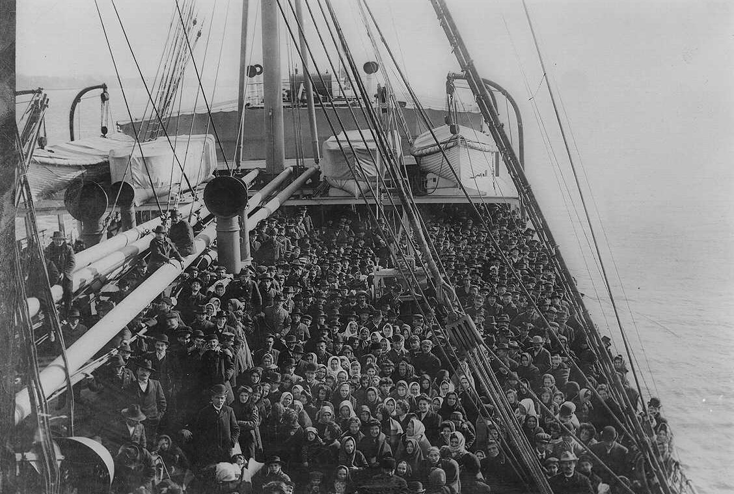
North part 3
Immigration and Reform

Slide 2
Urbanization
As word got out that factory jobs were available, people moved from rural areas to northern cities to earn money.
BIG CITY

Slide 3

Urbanization
The movement of the population from farms to cities is called urbanization.

Slide 4
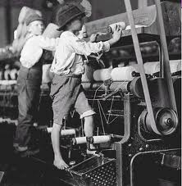
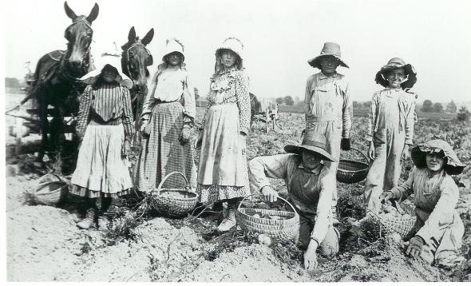
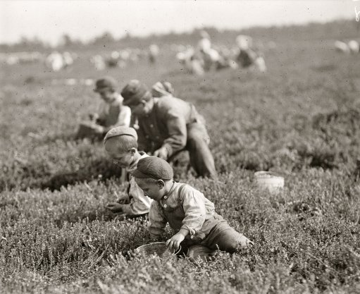
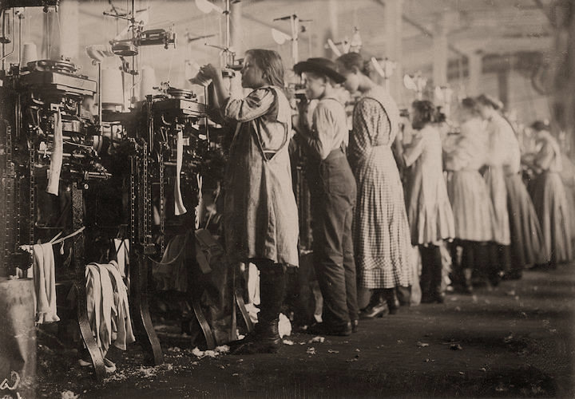
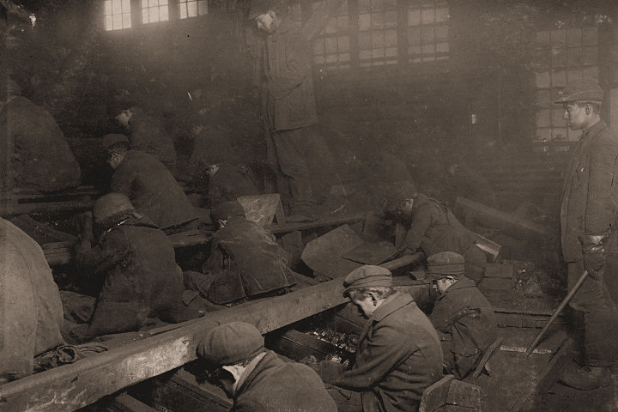
Children in the Factories
Often entire families including women and children were employed in factories. Everyone had to pitch in to make ends meet.
Since children had to work hard on farms they were expected to also work hard in factories.

Slide 5
Immigration
In addition to families moving from the countryside to take factory jobs, in the mid-1800’s there was a wave of immigration from Europe into northern cities.
The newcomers were people willing to work for low pay and this further increased competition for jobs.

Slide 6
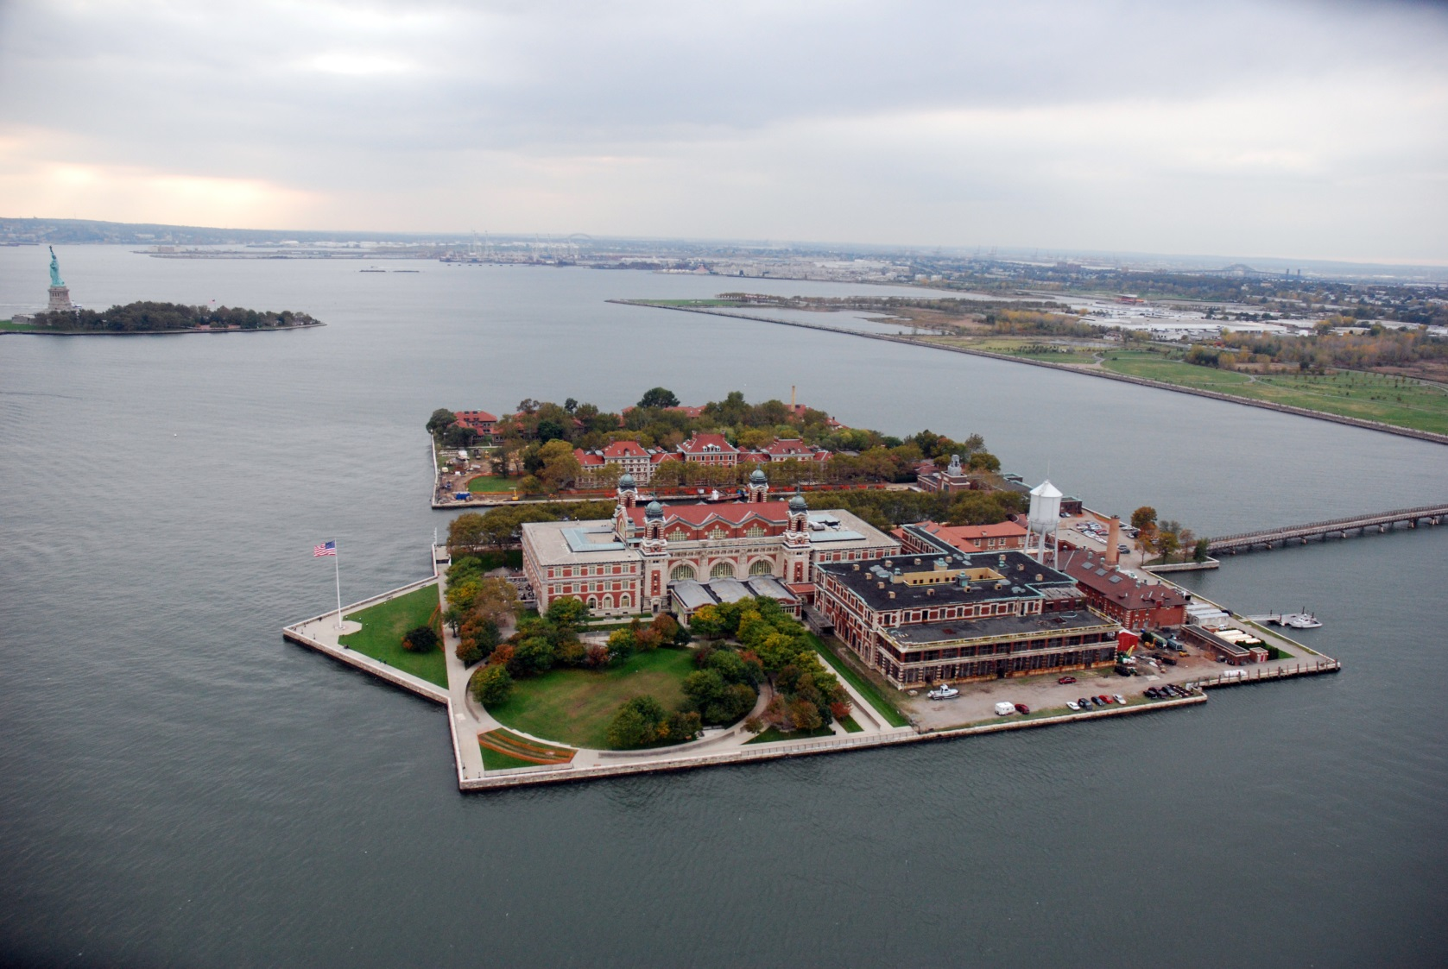
Ellis Island

Slide 7
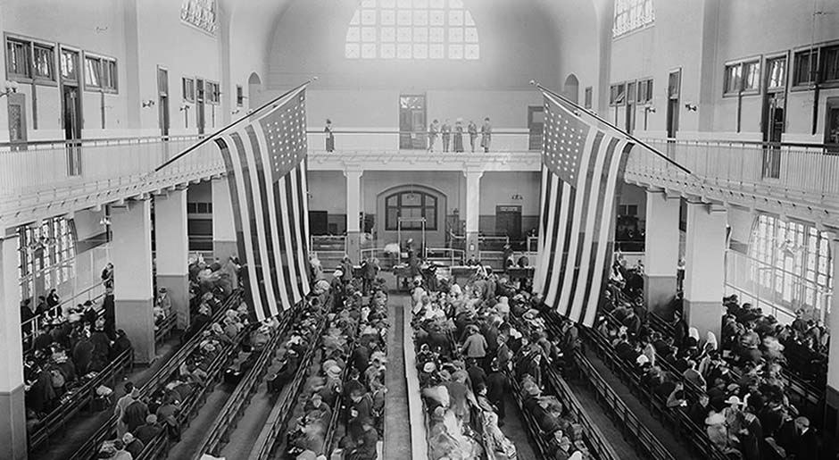

Slide 8
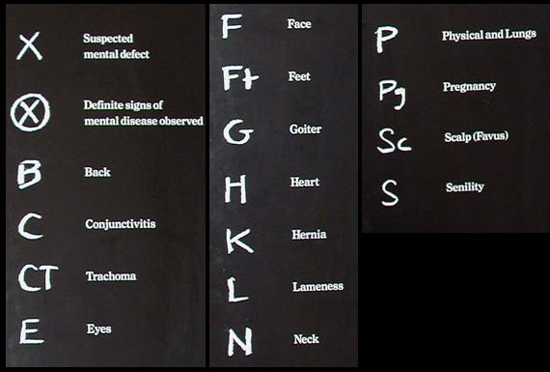
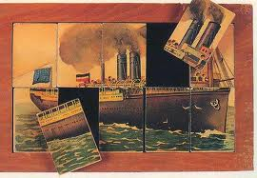

Slide 9
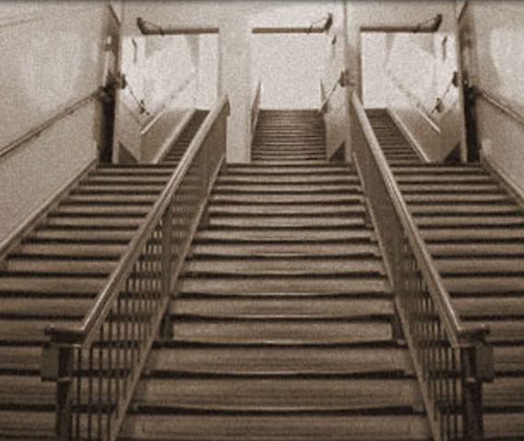

Slide 10
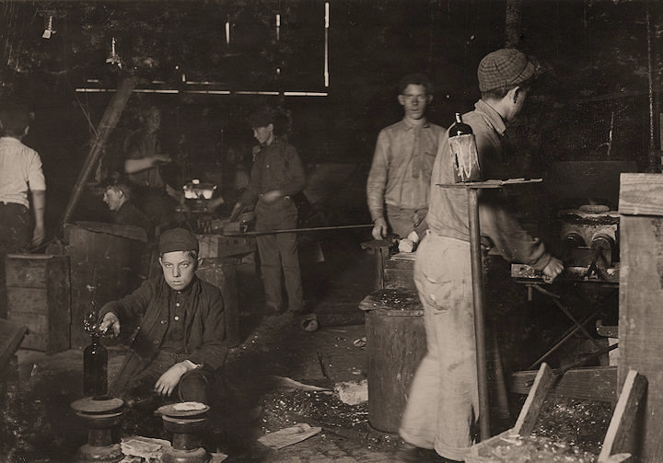
Working Conditions
Because there were so many workers available individual laborers became less important.
Employers realized that if people quit, others would take their place. Therefore, bosses worried less about creating safe and comfortable environments for their workers.
As a result, working conditions became very dismal (hard).

Slide 11

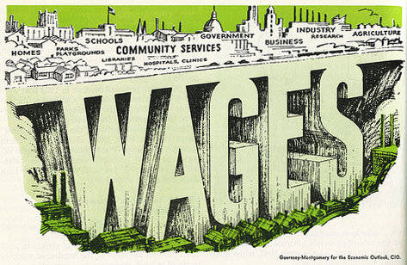
Working Conditions
Employees were forced to work longer, harder, and faster to keep up with new equipment.
Wages (pay) also
went down.

Slide 12
Working Conditions

Slide 13
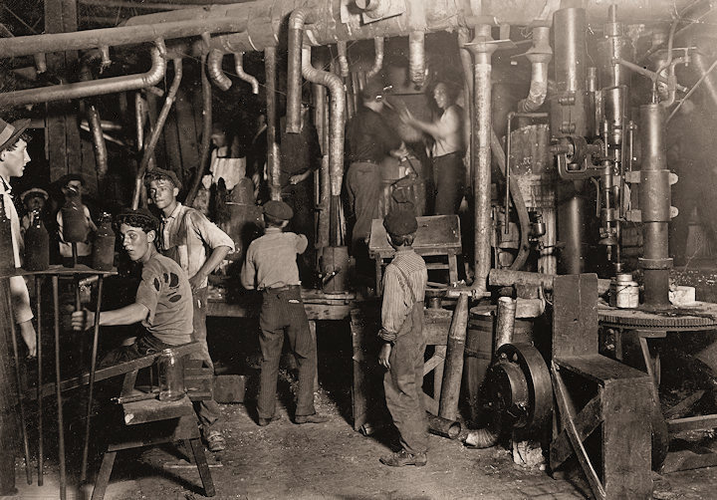
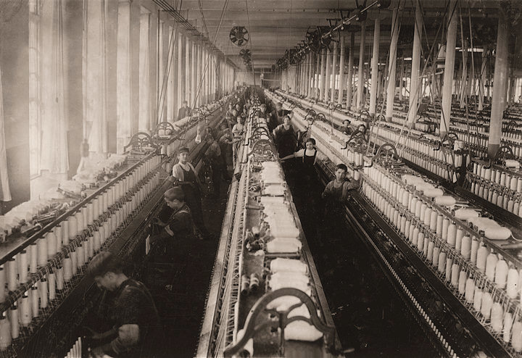
Working Conditions
Factory workers faced discomfort and danger. (Few factories had windows or heating systems. Factory machines had no safety devices. There were no laws regulating factory conditions)

Slide 14
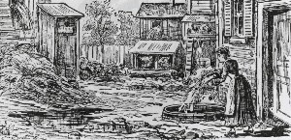
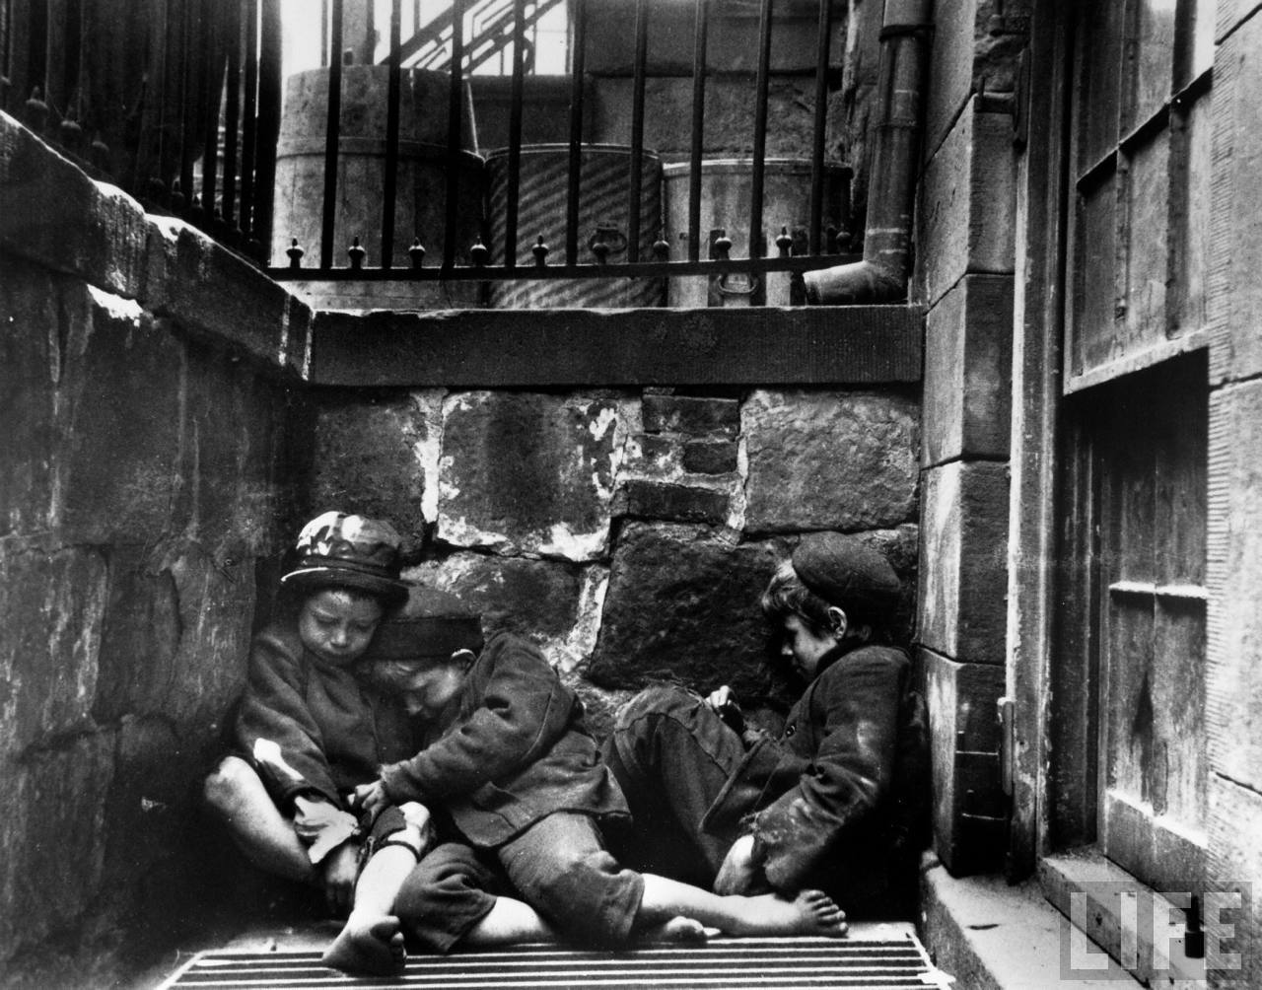
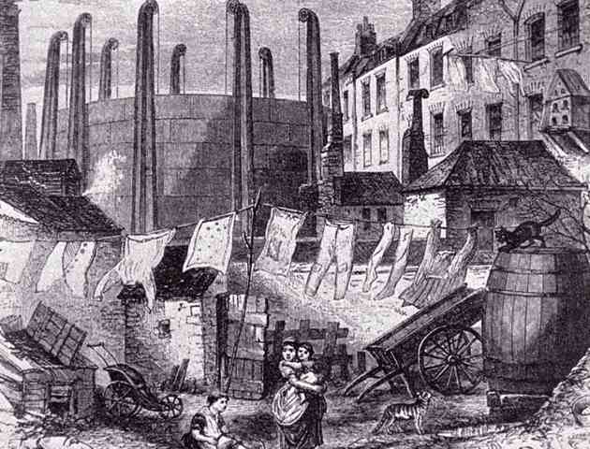
Slums
Workers often lived in slums next to the factories. The living quarters were small, dirty, and overcrowded.

Slide 15

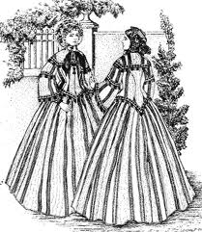

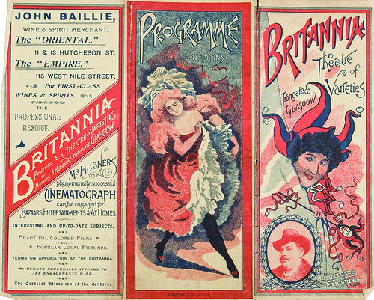
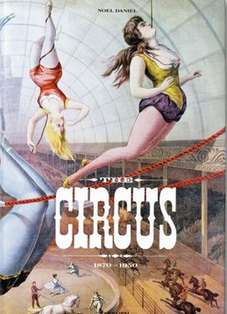
Cities
In addition to growing more dirty and crowded, there were also other changes in cities.
Cities developed attractions like theaters, museums and circuses that created an air of excitement.
They also had shops that had ready to wear clothing.

Slide 16
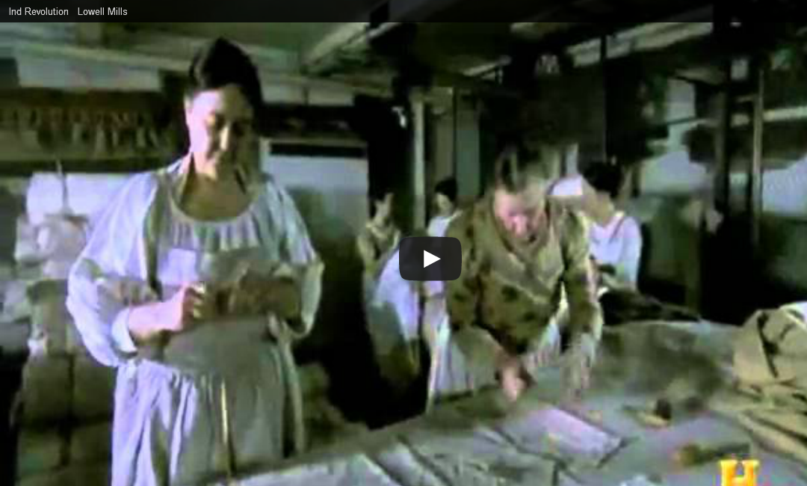
Women in the Factories

Slide 17
Beyond their years…

