Slide 1
Lesson 1
The Articles of Confederation

Slide 2
Objective
SWUT – The Articles of Confederation created a weak central government and a loose alliance of independent states.

Slide 3
Articles of Confederation
In forming new governments, most states wrote constitutions. These outlined the laws, principles, organizations and processes of government.
State Constitution

Slide 4
Articles of Confederation
Virginia and some other states also included a Bill of Rights. A document listing freedoms that the government promised to protect.
States Bills of Rights

Slide 5
Articles of Confederation
Delegates to the second continental congress determined that there needed to be a national government to prosecute the war for independence.
The Need for a National Government

Slide 6
Articles of Confederation
In 1777 they approved the Articles of Confederation, creating a very loose alliance of 13 independent states.
The Need for a National Government

Slide 7
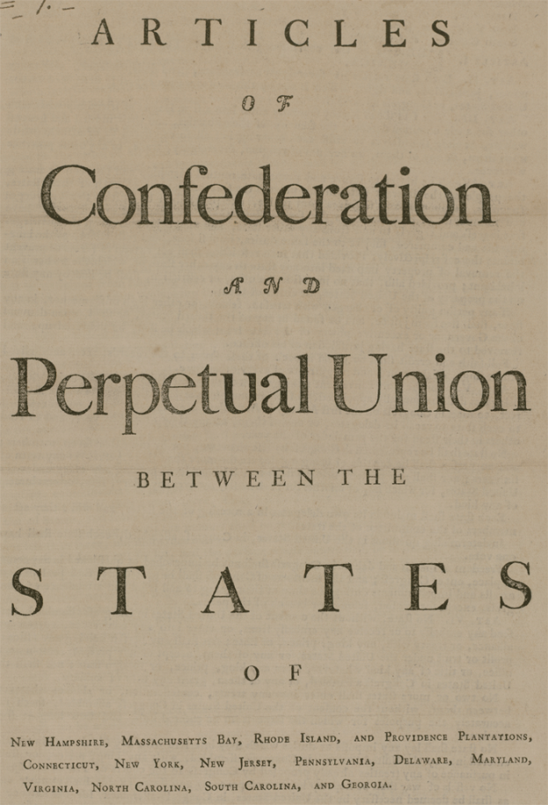
Articles of Confederation
Under the Articles each state could send however many delegates they wanted but each state would have one vote.

Slide 8
Articles of Confederation
Declare War
Appoint Military Officers
Coin Money
Manage Foreign Affairs
Congressional Powers
Under the Articles the Congress had the Following Powers

Slide 9
Articles of Confederation
All laws passed by congress had to be ratified by nine of the states before they would take effect.
Congress had the Power to Pass Law

Slide 10
Articles of Confederation
Congress had no authority to enforce its laws. Laws would be enforced by the States if they were willing.
Congress had the Power to Pass Laws

Slide 11
Articles of Confederation
Could not regulate trade
Could not tax
No executive authority
No court system
Limitations Placed on the Congress

Slide 12
Articles of Confederation
Maryland refused to adopt the articles until all states gave up their claims on land west of the Appalachians. They did and in 1781 the articles take effect.
The Articles are adopted and a new nation is born

Slide 13
Articles of Confederation
The Northwest Ordinance provided a method for new states to be admitted to the union and outlawed slavery in the territory.
Accomplishments Under the Articles of Confederation

Slide 14
Articles of Confederation
Once a territory had a free population of 60,000 it could apply to congress for admission as a state equal to the existing 13 states.
Accomplishments under the Articles of Confederation

Slide 15
Articles of Confederation
The land ordinance of 1785 divides the Northwest territory into townships and sections. Sections sell for $640 ($1 per acre then or around $14 in today’s money).
Accomplishments under the Articles of Confederation

Slide 16
The Articles of Confederation
A township consisted of 36 one square mile sections. One section per township was set aside to support public schools.
Accomplishments under the Articles of Confederation

Slide 17
The Articles of Confederation
The articles did not give congress the right to resolve disputes between the states.
Weaknesses in the Articles

Slide 18
The Articles of Confederation
Although given the authority to coin money, the congress had no way to raise revenue and was deeply in debt making its coinage worthless.
Weaknesses in the Articles

Slide 19
The Articles of Confederation
The new nation was weak.
Britain refused to withdraw from the Ohio valley.
Spain closed the port of New Orleans to American commerce.
Weaknesses in the Articles

Slide 20
The Articles of Confederation
After the war the new nation entered a period of economic depression.
Congress was powerless to do anything to help.
Shay’s Rebellion

Slide 21
The Articles of Confederation
As farmers returned from the army to their fields, crop supplies rose while the demand fell.
As a result, the prices for farm products fell.
Shay’s Rebellion

Slide 22
The Articles of Confederation
At the same time in Massachusetts, government raised taxes.
Farmers who were already hurting couldn’t pay the increased taxes.
Shay’s Rebellion

Slide 23
The Articles of Confederation
Massachusetts began to seize the farms of those who were delinquent on their taxes.
Shay’s Rebellion

Slide 24
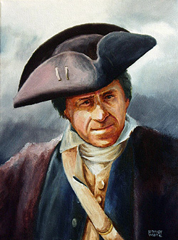
The Articles of Confederation
Angry farmers led by Daniel Shays, a Patriot war hero, took up arms to prevent the government from seizing farms.
Shay’s Rebellion

Slide 25
The Articles of Confederation
Massachusetts had to call out the militia to put down the rebellion.
This convinced many of the need for a stronger national government.
Shay’s Rebellion

Slide 26
The Articles of Confederation
In May of 1787, a convention was called to strengthen the articles.
Instead they completely rewrote the constitution.
An Attempt to Revise the Articles

Slide 27
The end of the confederation, the beginning of the Federal Union.

