Slide 1
Day 1
The Explorers

Slide 2
Objective
*Swut – Despite early contacts, Europeans began to explore the Americas fully only after Columbus’ voyage.

Slide 3
The Explorers
At the beginning of the 11th century, a Viking by the name of Leif Ericson made it to America. The Vikings sailed from Greenland and established a base for harvesting timber in Newfoundland Canada.

Slide 4
The Explorers
This base located at L’Anse aux Meadows was abandoned because the natives they called Skraelings were unfriendly.

Slide 5
The Explorers
In the 15th century, the Ottoman Turks gained control of the Islamic world and cut off European access to the goods coming from the Indies.

Slide 6
The explorers
The Portuguese attempted to trade with the Indies by sailing around Africa.

Slide 7
The explorers
The South Atlantic Currents made it difficult to follow the African coast so the Portuguese learned to sail southeast to the Cape of Good Hope.

Slide 8
The explorers
Blown off course, Pedro Alvares Cabral landed on the coast of Brazil in 1500 AD. This was just 8 years after the first voyage of Columbus.

Slide 9
The explorers
In 1498, just 6 years after Columbus’ first voyage Vasco da Gama landed in Calcutta, India and the Portuguese took the lead in trading with the Indies.

Slide 10
The explorers
Around 240 BC, the Greek scholar Eratosthenes in Alexandria, Egypt calculated the Circumference of the earth to within 900 miles.

Slide 11
The explorers
In 1492, Christopher Columbus calculated the circumference of the earth as 9,000 miles less than it really is.

Slide 12
The explorers
In 1492 he convinced Ferdinand and Isabella of Spain to Finance an expedition to sail west to the Indies.

Slide 13
The explorers
Sailing West, Columbus discovered the Caribbean islands almost where he expected to find the coast of Cathay (China) considered part of the Indies.

Slide 14
The explorers
Believing he had landed in the Indies, Columbus called the natives “Indians” a name which has persisted. Today most native Americans call themselves Indians.

Slide 15
The explorers
In 1513, Vasco Nunez de Balboa crossed the isthmus of Panama and arrived at the shore of the Pacific Ocean. He claimed all lands the water touched for Spain.

Slide 16
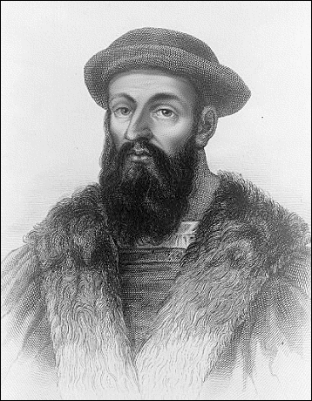
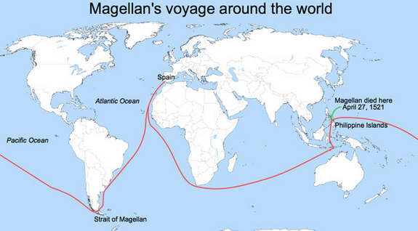
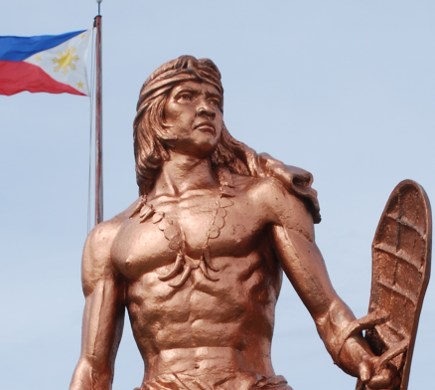
The explorers
From 1519 to 1522 an expedition led by Ferdinand Magellan circumnavigated the globe. Only 18 of the original 280 men and 1 of 5 ships completed the voyage.

Slide 17
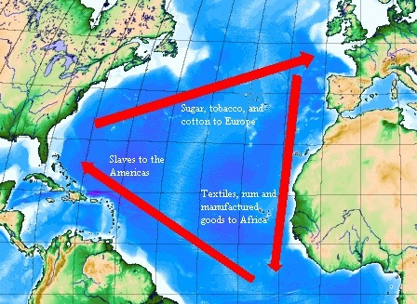
The explorers
This exchange of goods and ideas between the Eastern Hemisphere and Western Hemisphere is called the Columbian Exchange.

Slide 18
The explorers
The discovery of the Americas at the close of the 15th century sparked an exchange of goods and ideas that transformed both the old and new worlds and ushered in the first Global Age.

