Slide 1
Unit 2 Review
Internal and External Forces

Slide 2
Can You Identify Them?
Unit 2 Vocabulary:
Plate Tectonics
Erosion
Mechanical Weathering
Chemical Weathering
Geology
Weathering
Core
Crust
Mantle
Identify each picture according to your vocabulary

Slide 3
1. Geology
The Study of the earth’s physical structure and history.

Slide 4
2. Mechanical Weathering
The actual breaking up or physical weakening of rock by forces such as ice and roots

Slide 5
3. Plate Tectonics
The theory that the earth’s outer shell is composed of large, unanchored plates, or slabs of rock, which constant movement explains earthquakes and volcanic activity.

Slide 6
4. Core
The Center of the earth.

Slide 7
5. Weathering
The chemical or mechanical process by which rock is broken down, eventually becoming soil.

Slide 8
6. Crust
The solid, rocky, surface layer of the earth.

Slide 9
7. Erosion
The movement of weathered materials, including gravel, soil, and sand, usually caused by water, wind and glaciers.

Slide 10
8. Mantle
A thick layer of mostly solid rock beneath the earth’s crust that surrounds the earths core.

Slide 11
9. Chemical weathering
The process by which the actual chemical structure of a rock is changed, usually when water and carbon dioxide cause a breakdown in the rock.

Slide 12
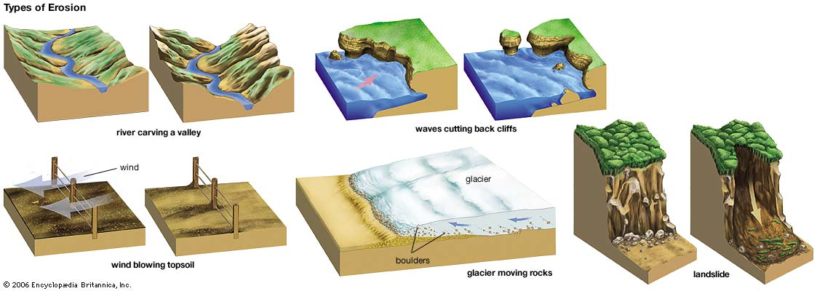
The 3 MOST common types of erosion:
Water
Wind
Glaciers

Slide 13
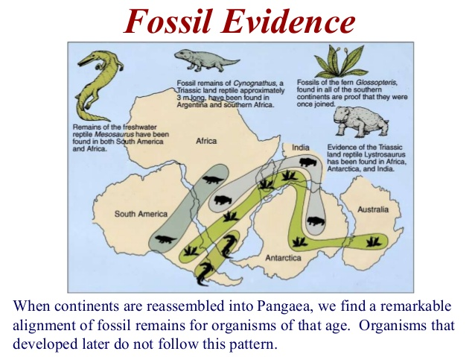
One of the best theories for plate tectonics is…

Slide 14
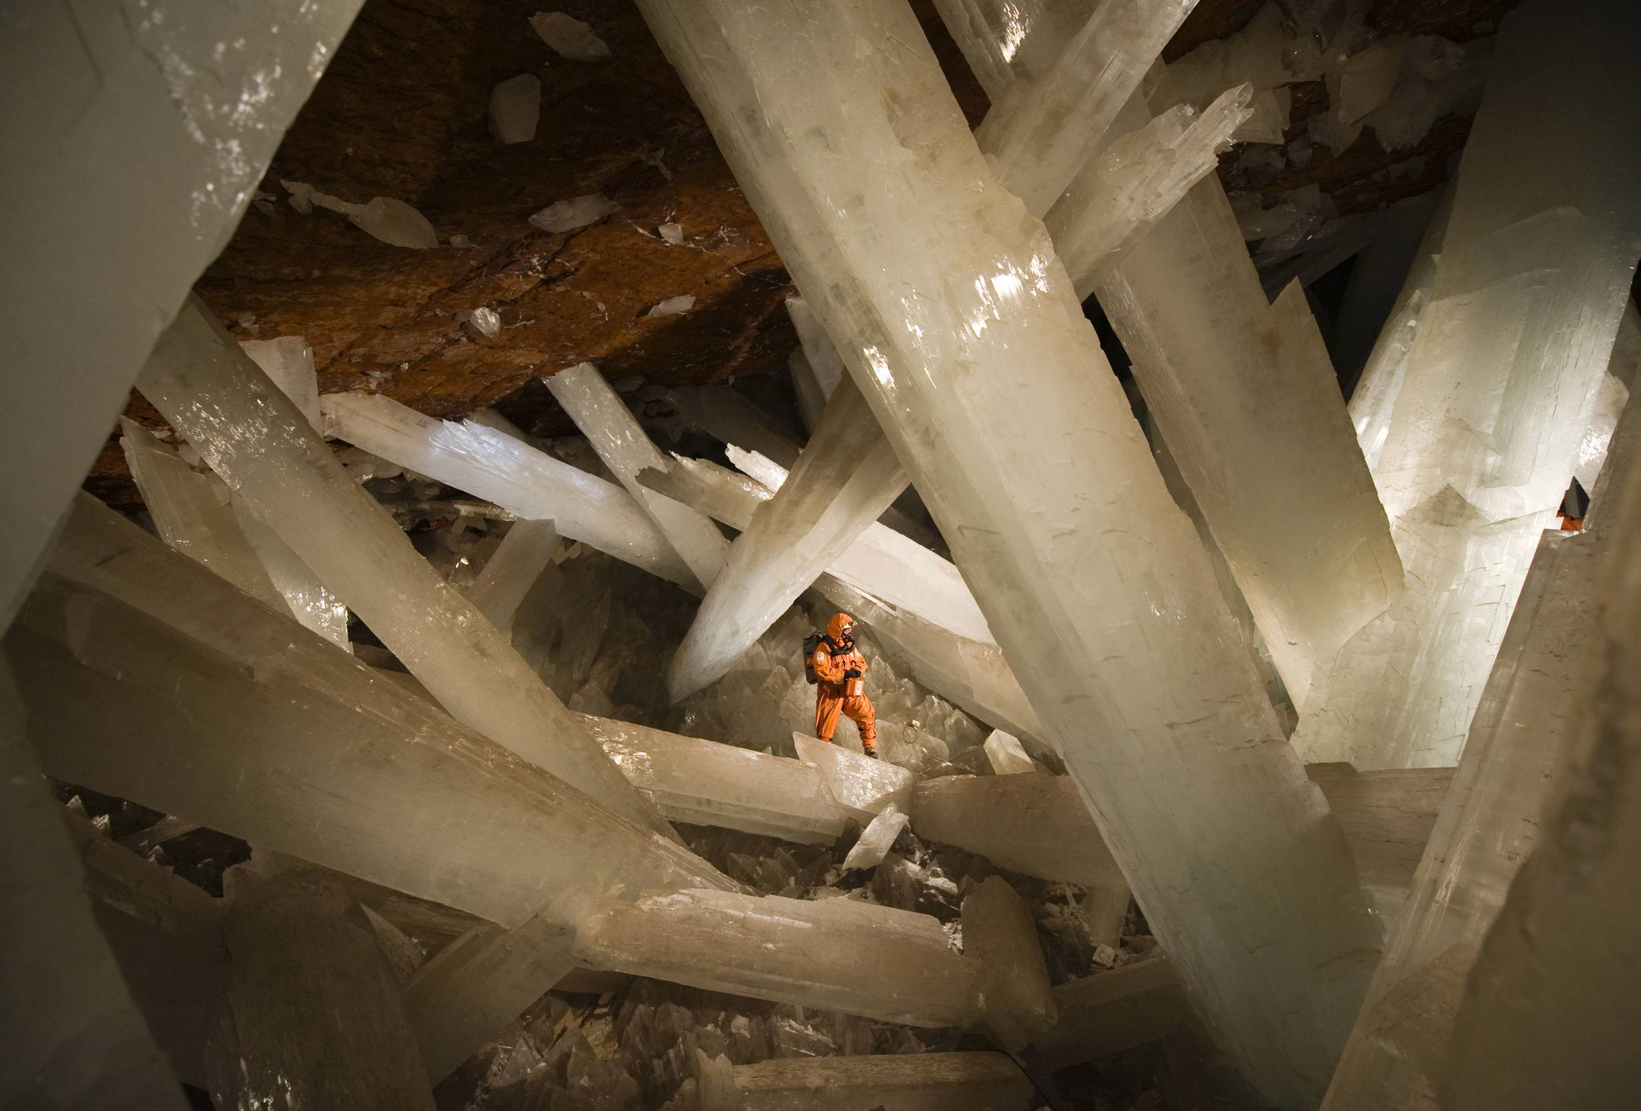
One effect of chemical weathering is…
…It changes the composition of the rock.

Slide 15
The End
Now have a great Test!!!

