Slide 1
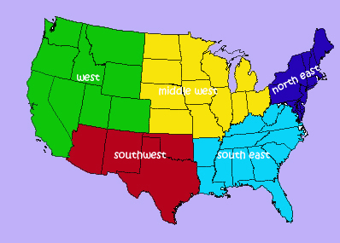
Regions of the United States

Slide 2
Class Outline
Northeast
South
Midwest
West

Slide 3
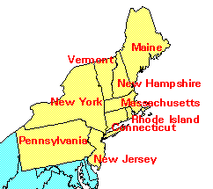
The Northeast
Northeast
Maine, New Hampshire, Vermont, Massachusetts, Connecticut, Rhode Island, New York, New Jersey, Pennsylvania, Delaware, Maryland, and the District of Columbia

Slide 4
Physical Geography of Northeast
Northern Appalachian mountains run through most of the northeastern states, causing little farmland, except in valley areas.
Deep bays exist, allowing for port towns.
Jagged, rocky coastline in northern areas.

Slide 5
Climate and Vegetation of Northeast: Humid Continental
No Dry Season- this area receives precipitation throughout the year.
Cold, snowy winters and hot summers.
Moderate growing season that decreases as you go north.
Vegetation is mixed forests with deciduous and coniferous trees.

Slide 6
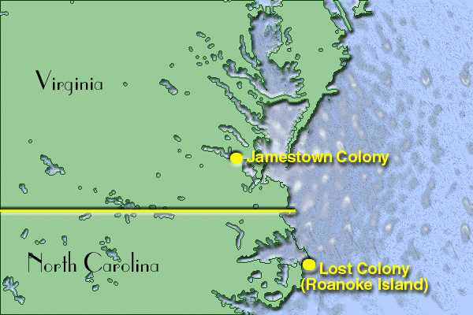
Historical Geography of the Northeast
The Northeast has the longest history of European settlement .
Historically, the Northeast has been the gateway to immigrants.
Established itself as the financial and manufacturing hub early in the industrial revolution.

Slide 7
Population Geography of the Northeast
Population is concentrated in the Megalopolis that runs from Boston to Washington (AKA Bosnywash).
This is the most densely populated region in the United States.

Slide 8
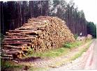
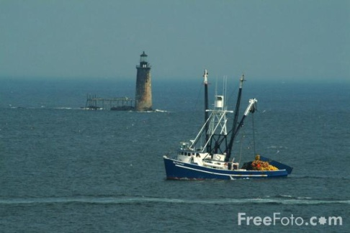
Land Use in the Northeast
Dairy Farming
Farming
Timber
Maritime Activity
Some Mining
Note: As you go north, the growing season shortens, which limits farming. In part of the Northeast, timber is a primary economic activity.

Slide 9
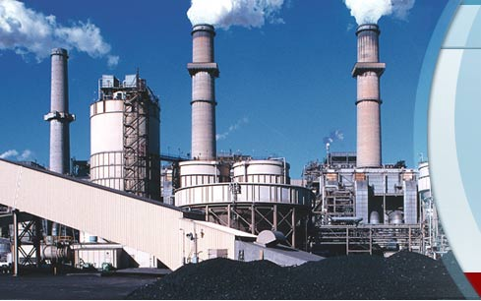
Economic Geography
Northeast is the heart of the Manufacturing core, but lately has been termed the RUST BELT. This extends into the Midwest.
Why do you think it’s called the Rust belt? Where have industries relocated? Why?

Slide 10
New England Legacy
New England is famous for its “prep schools” and is home to some of the most elite Universities in the world: Harvard, Yale, MIT, Boston College, Brown, and Dartmouth (just to name a few).
One of the best resources New England has is its educated population.

Slide 11
New England Politics
New England is generally progressive in politics and states usually are affiliated with the Democratic party, although some rural areas tend to vote Republican.

Slide 12
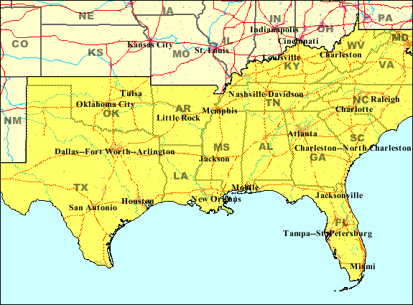
The South
States included: North Carolina, South Carolina, Florida, Georgia, Alabama, Mississippi, Tennessee, Arkansas, and Louisiana.
Transition States: Virginia, W. Virginia, Kentucky, Missouri, Oklahoma, and Texas

Slide 13
Climate and Vegetation of the South
Humid subtropical, with hot, humid summers and long growing season. Winters are mild, seldom with snow. There is no dry season.
Vegetation: Mixed forests. The South is known for plants such as live oaks, magnolia trees, flowering dogwoods.

Slide 14
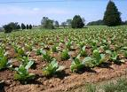
Economic Geography of the South
Historically based on agriculture, with tobacco and cotton being the first cash crops.
Fishing is a common activity in Gulf Coast States.
Tourism along the Gulf Coast, especially Florida.
Oil Industry is located in the Gulf and in cities like Houston and Beaumont, close to continental shelf drilling.

Slide 15
Political Activity
The South is known for its conservatism.
The Republican Party dominates the South as a result.
Resistance to same-sex marriage, abortion, feminism, desegregation, and the abolition of slavery are part of the political history of the South.

Slide 16
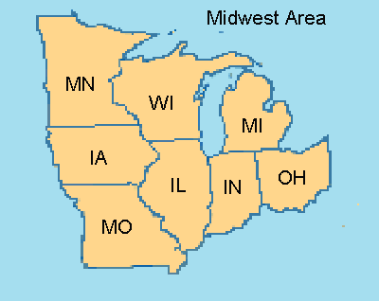
Midwest
Included States: Michigan, Ohio, Indiana, Illinois, Wisconsin, Minnesota, and Iowa
Transition States: Pennsylvania, Missouri

Slide 17
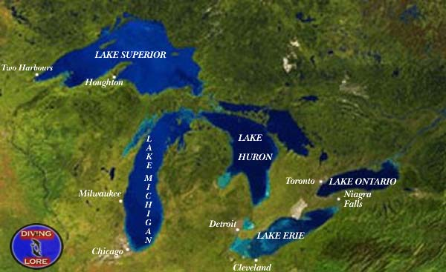
Physical Geography of Midwest
Flat landscape, with river basins.
Distinctive Great Lakes, which provide for shipping.

Slide 18
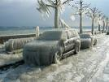
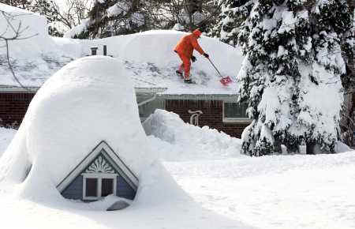
Climate of the Midwest: Humid Continental
No Dry Season- this area receives precipitation throughout the year.
Cold, snowy winters and hot summers.
Moderate growing season that decreases as you go north.
Vegetation is mixed forests with deciduous and coniferous trees.

Slide 19
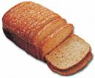
Historical Geography of the Midwest
The Mid-west was considered the “Western Frontier”, hence the name.
Historically known as the breadbasket of the U.S., as this is also an agricultural region.
Also known as a manufacturing, blue-collar hub of the U.S.

Slide 20
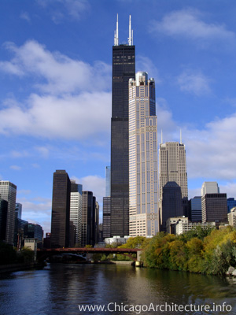
Population
Large cities include Chicago and Detroit
The region is evenly distributed.
Population is dense along the Great Lakes.

Slide 21
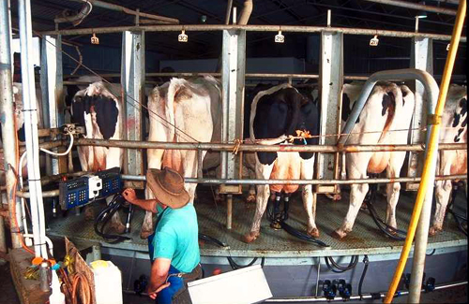
Economic Geography
Dairy Farming in Wisconsin and Minnesota
Fruit Orchards in Michigan
Corn in Indiana, Illinois, and Iowa
Manufacturing in urban cities along Great Lakes, like Pittsburgh, Cleveland, Detroit and Chicago (Steel Towns).

Slide 22
Breadbasket of the USA
Corn is most notably grown, but soybeans, wheat, and fruits orchards are also commonly found throughout the Midwest.
Dairy products are famous in which state in the Midwest?

Slide 23
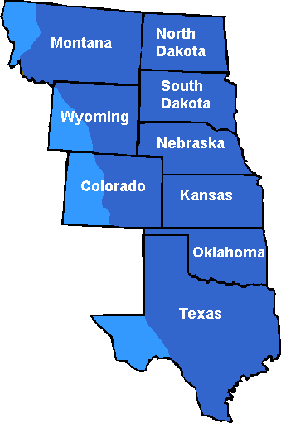
Great Plains Region
Strip of States through the center of the Country.
Includes: Kansas, Nebraska,
South Dakota, and North Dakota.
Transition States: Oklahoma,
Panhandle of Texas,
Eastern Colorado, Wyoming
and Montana.
,

Slide 24
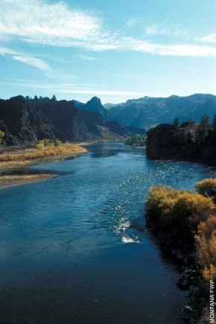
Physical Geography of the Great Plains
The Great Plains are also called the High Plains, as the elevation increases gradually as you go west.
Generally flat with some rolling hills.
Major River Basins: Red R., Arkansas River, Platte River, and the Missouri River.

Slide 25
Climate of the Great Plains
This area receives little rainfall (less than 18 in. a year on average).
Cold Winters, especially in the northern areas.

Slide 26
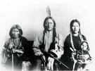
Historical Geography of the Great Plains
Before Americans settled the frontier, the Great Plains was home to several Indigenous culture, most notably the Sioux and the Cheyenne.
During the 19th century, the Great Plains became the staging point of war between the native people and the American settlers.

Slide 27
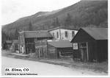
Homestead Act of 1862
This act provided each settler with 160 acres of land, as long as he cultivated the land.
This caused a rush of settlers to the Great Plains region in the 1800s.
Ironically, the Great Plains has lost a third of its population since 1920. Kansas has 6,000 ghost towns.

Slide 28
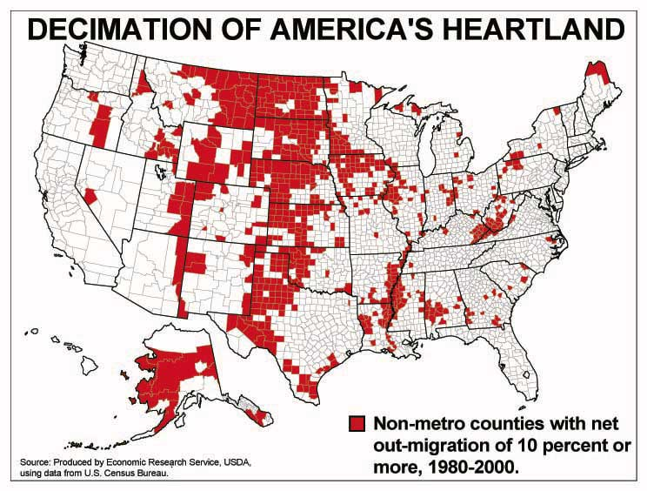
Population of the Great Plains
Two words: Rural and declining.

Slide 29
Mountain and Basin States
States included: New Mexico, Colorado, Wyoming, Montana, Idaho, Utah, Nevada, Arizona
Transitions: Colorado, Wyoming and Montana are also Great Plains States
Southwest: Texas, New Mexico, Arizona, Southern Utah/Nevada.

Slide 30
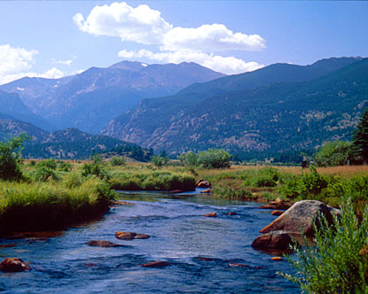
Physical Geography
Characterized by the steep and jagged Rocky Mountain Range.

Slide 31
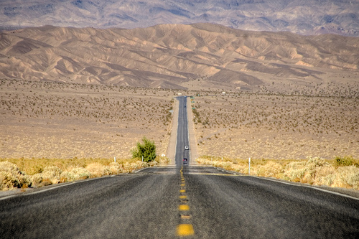
Climates
Highland climate is found throughout the Rockies
Deserts
In general, the area is
arid.
Farming is done
with irrigation.

Slide 32
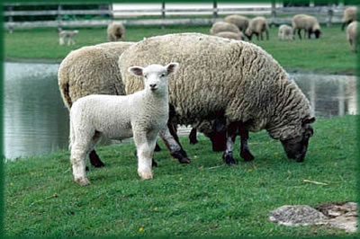
Historical Geography
Mining towns
Outlaws (Wild West)
Cattle/Sheep Grazing
Reservation Lands
Las Vegas and Reno-
Gambling towns
National Park Service

Slide 33
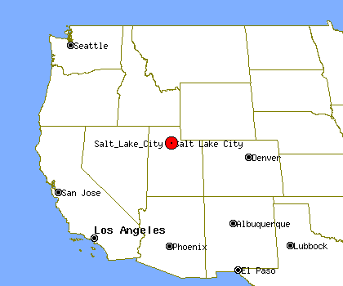
Population Geography
Not densely populated.
Major urban centers include: Denver, Salt Lake City, Phoenix.

Slide 34
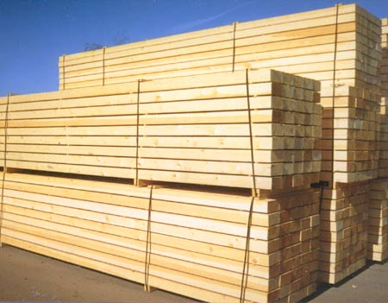
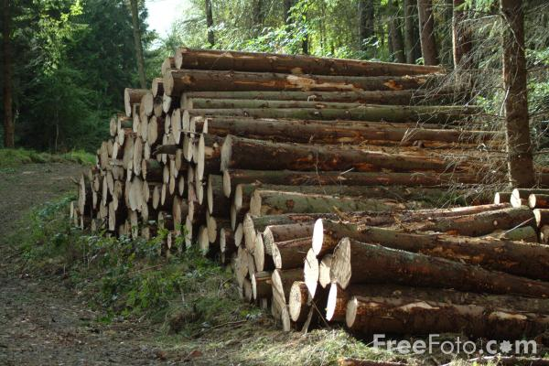
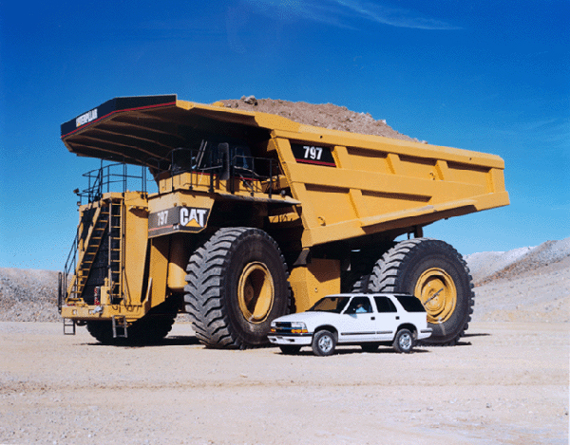
Economic Activity
Grazing
Mining
Tourism
Lumber

Slide 35
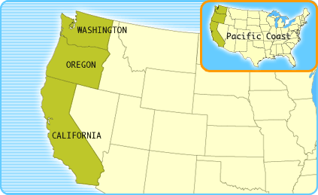
Pacific Coast States
California, Oregon and Washington

Slide 36
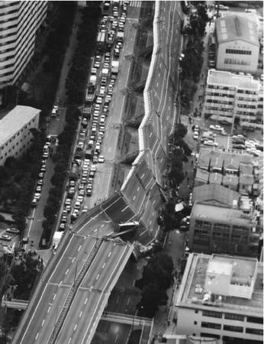
Physical Geography of West Coast
Mountain Ranges (Sierra Nevada and the Cascades) and Rocky coastlines due to subduction forces.
Physical hazard exist across
the region due to tectonic forces.

Slide 37
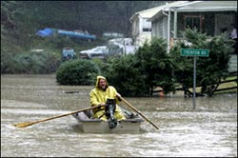
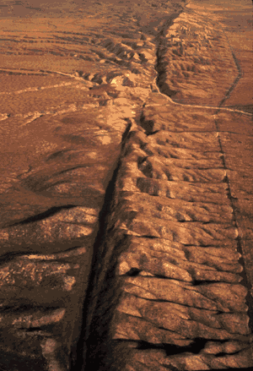
Southern California
The continual presence of natural hazards, including fire, flood, earthquakes, and intense drought, has done little
to reduce the growth of this
area
San Andreas Fault
Los Angeles is the 2nd largest
city in the U.S.

Slide 38
Population Geography
More dense along the coastal areas, especially between San Diego, LA, and San Francisco.
Other urban centers exist around Seattle and Portland.

Slide 39
Economic Activity
Movie Industry
Wine (Napa and Sonoma)
Tourism
Fishing on the coast

Slide 40
Western Politics
The West coast states are known for their liberalism in politics.
Examples: Oregon has legalized euthanasia, all have legalized medicinal marijuana, Numerous states recognize same-sex marriage

