Slide 1
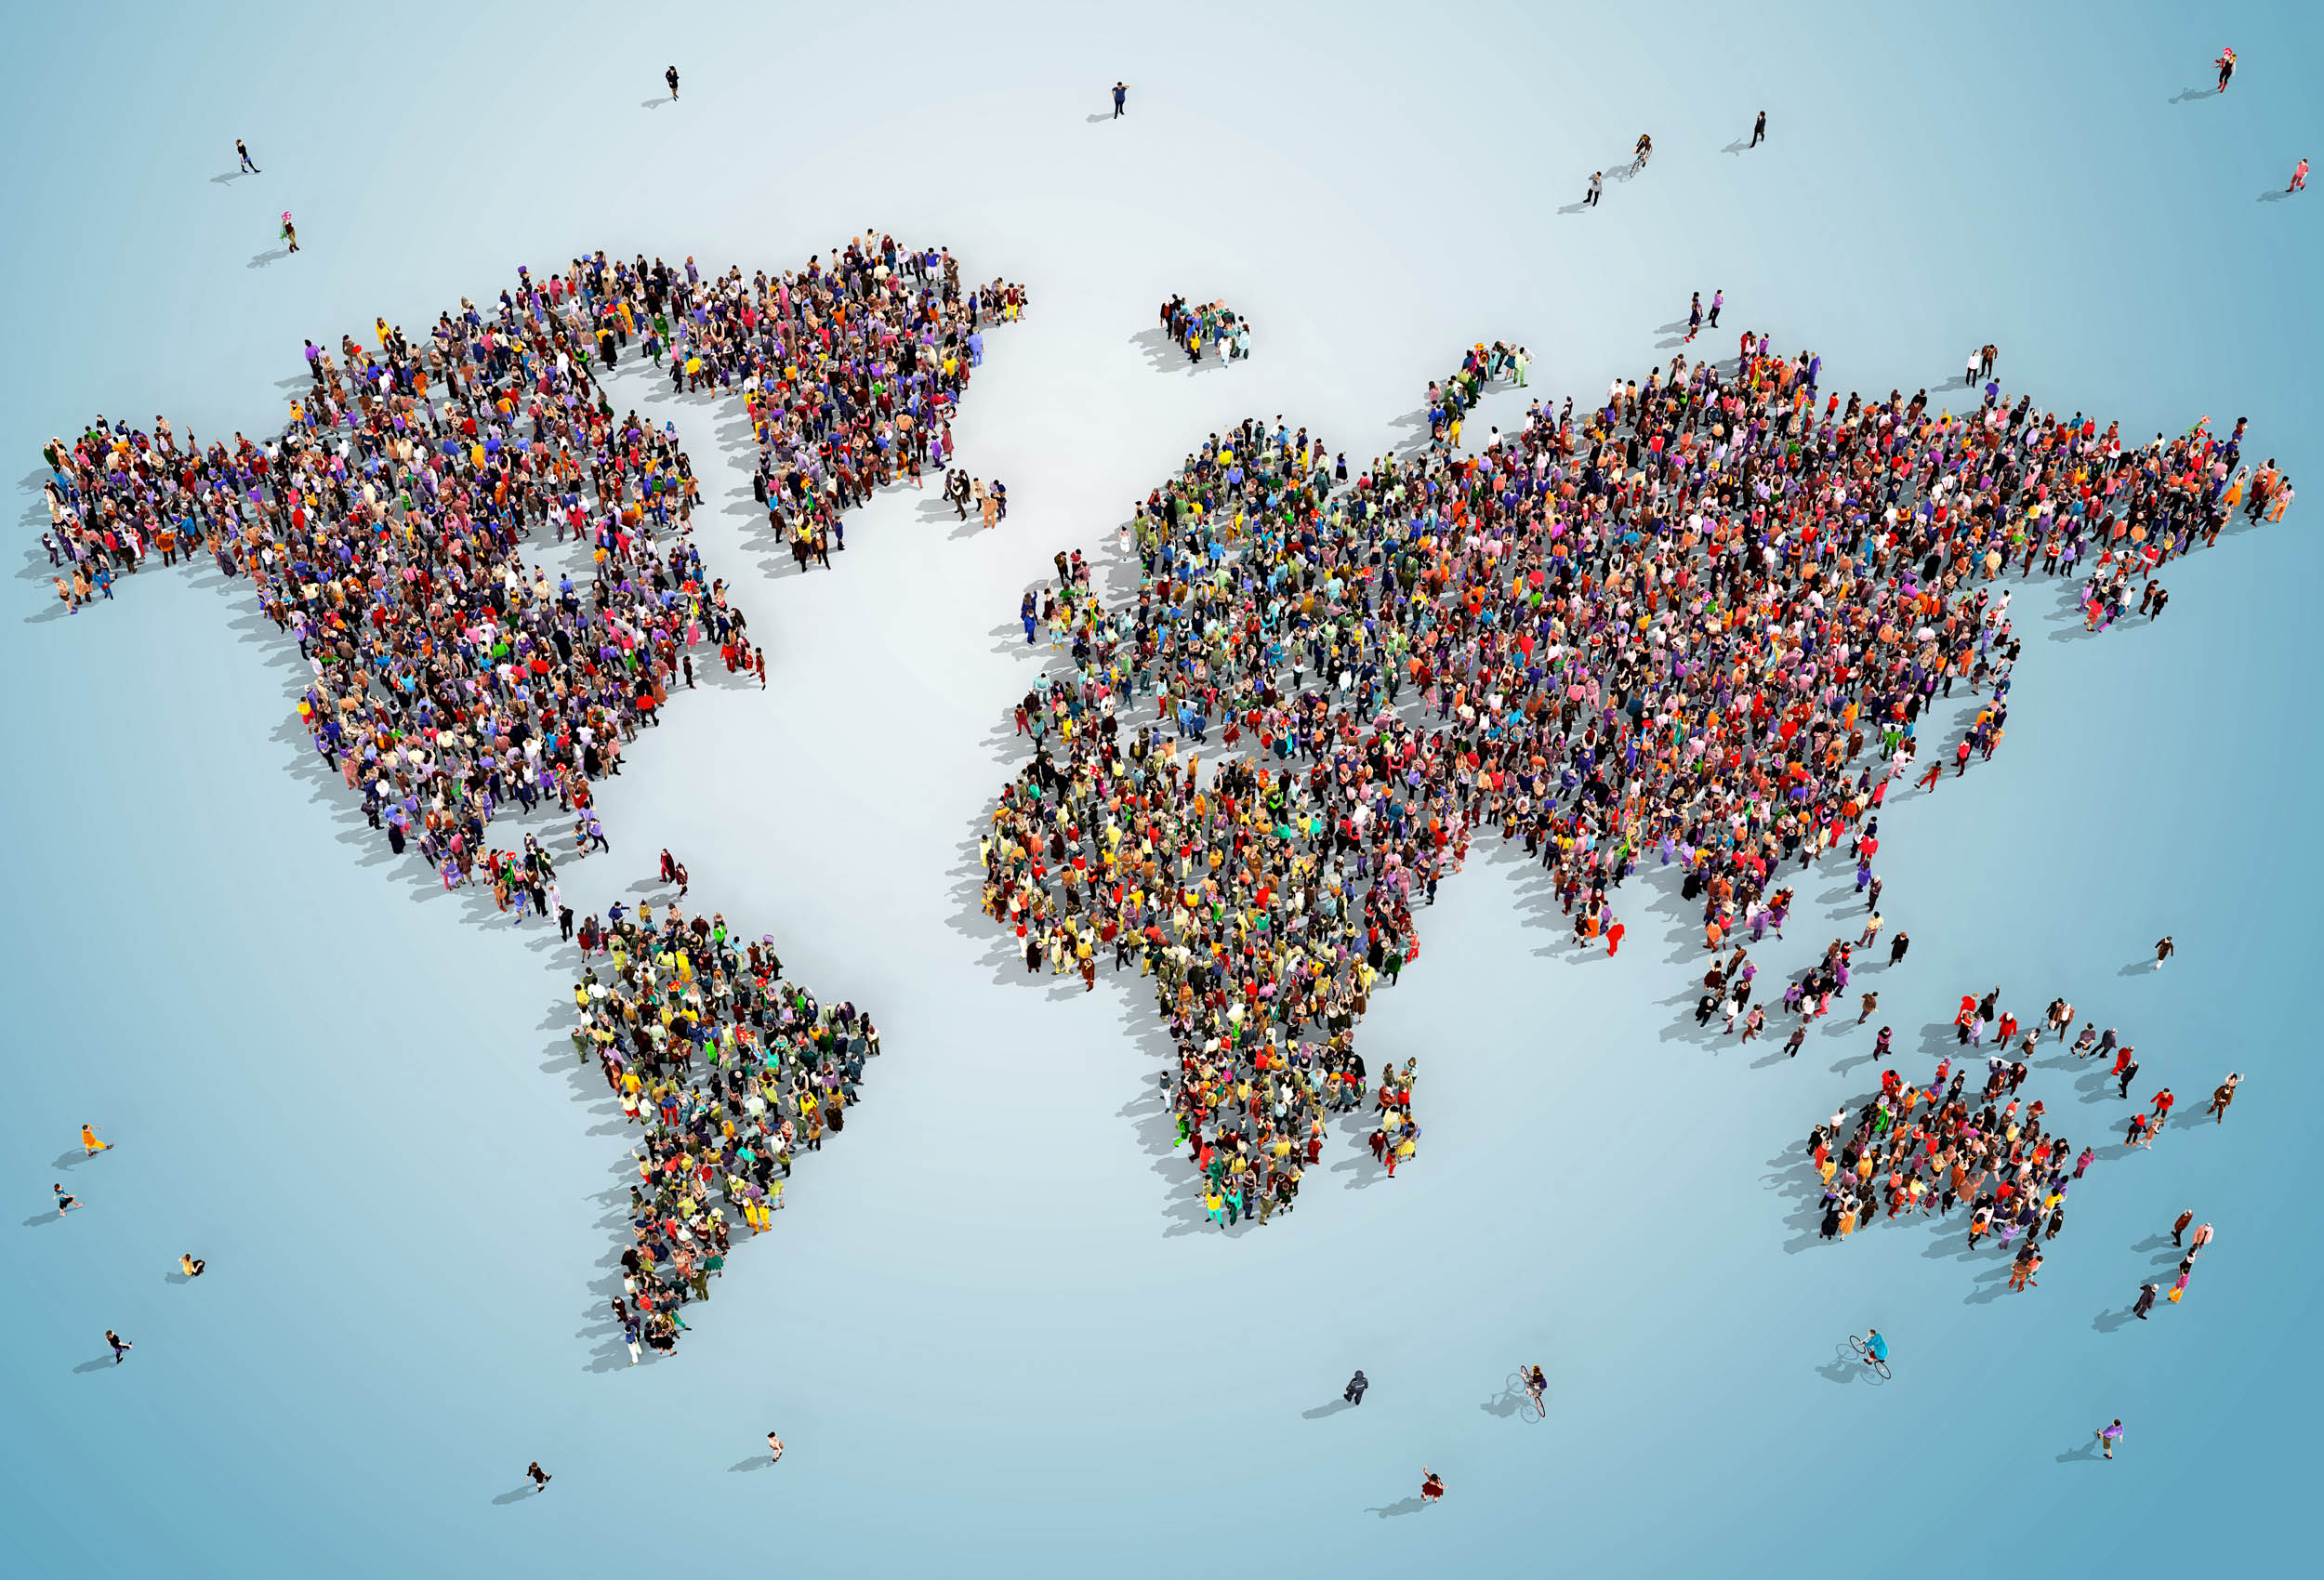
Unit 5: The Human World

Slide 2
Global Cultures
Elements of Culture
Language
Religion
Daily life
History
Art
Government
Technology
Economy

Slide 3
Global Cultures
Elements of Culture
Include different ethnic groups
Ethnic group: people who share a common language, history, or place of origin.

Slide 4
Global Cultures
Social Culture
The most important unit of social organization in all cultures is the family.

Slide 5
Global Cultures
Elements of Culture
Cultural regions:
Areas with certain traits in common
i.e. similar economic systems or government

Slide 6
Global Cultures
Cultural Change
Constantly changing:
New ideas
Lifestyles
Inventions
Spatial interactions (such as trade and migration).

Slide 7
Global Cultures
Cultural Change
The first civilizations arose in culture hearths
(a place of origin for a widespread cultural trend)
Emerged from farming settlements

Slide 8
Global Cultures
Cultural Change
Food surplus = focus on long-distance trade
Led to the development of complex social systems

Slide 9
Global Cultures
Cultural Change
Technology
Increases cultural contact
Promotes cultural change as ideas spread

Slide 10
Population Geography

Slide 11
Population Geography
Population Growth
Over 7 billion people live on Earth
Most live on about 30 percent of the planet's land area

Slide 12
Population Geography
Population Growth
Population changes over time depending on
Birthrate
Death rate
Migration

Slide 13
Population Geography
Population Growth
Challenges of rapid growth:
Food
Water
Housing
Health care
Access to medicine & technology
Loss of cultural traditions.

Slide 14
Population Geography
Population Distribution
Settlements usually have:
Fertile soil
Water access
Mild climate

Slide 15
Population Geography
Population Distribution
They generally avoid
Mountains
Deserts
Tundra areas

Slide 16
Population Geography
Population Distribution
Population density:
Population divided by area

Slide 17
Population Geography
Population Distribution
Urbanization:
Moving from rural villages to cities
Trying to find a better life and jobs

Slide 18
Political Geography

Slide 19
Political Geography
Features of Government
Nearly 200 countries on Earth
Vary in:
Size
Military might
Natural resources
World influence

Slide 20
Political Geography
Features of Government
Unique governments reflect countries’ histories

Slide 21
Political Geography
Features of Government
Three major groups:
(1) autocracy, rule by one person
(2) oligarchy, rule by a few people
(3) democracy, rule by many people

Slide 22
Political Geography
Geography and Government
Countries determine:
How states or provinces are divided
How they will be governed

Slide 23
Political Geography
Geography and Government
Geography influences governments
How to provide people with goods and services
Build infrastructure (roads, bridges, and power plants)

Slide 24
Political Geography
Geography and Government
Natural boundaries, i.e. mountains and rivers
Cultural boundaries, i.e. religion or language
Geometric boundaries, made by humans.

Slide 25
Political Geography
Conflict and Cooperation
Conflicts:
Border disputes
Multiple ethnic groups within one area
Competition for resources
Control of strategic sites.
India/China border dispute

Slide 26
Political Geography
Conflict and Cooperation
Other political conflicts include nationalism and terrorism

Slide 27
Political Geography
Conflict and Cooperation
The United Nations (UN)
International organization
Facilitates cooperation between countries
Goal is world peace.

Slide 28
Economic Geography

Slide 29
Economic Geography
Economic Systems
Economic systems answer 3 questions:
What to produce?
How to produce?
For whom to produce?

Slide 30
Economic Geography
Economic Systems
Three types of economies:
Traditional economy
Market economy
Command economy

Slide 31
Economic Geography
Economic Systems
US = Mixed economy
Government supports and regulates free market.

Slide 32
Economic Geography
Economic Systems
Traditional economy: habit and custom determine economic rules

Slide 33
Economic Geography
Economic Systems
Market economy: individuals and private groups decide what to produce

Slide 34
Economic Geography
Economic Systems
Command economy: the government owns or directs the means of production.

Slide 35
Economic Geography
Economic Development
Primary economic activities
Taking or using natural resources directly from Earth

Slide 36
Economic Geography
Economic Development
Secondary economic activities
Use raw materials to make a product

Slide 37
Economic Geography
Economic Development
Tertiary economic activities
Provide services

Slide 38
Economic Geography
Economic Development
Quaternary economic activities
Process, manage, and distribute information

Slide 39
Economic Geography
Economies and World Trade
Trade:
Countries export specialized products
Sell to countries that cannot produce

Slide 40
Economic Geography
Economies and World Trade
International trade is costly due to…
Tariffs
(a tax or duty to be paid on a particular class of imports or exports)
Time costs
Expenses associated with different languages, legal systems, or other cultural barriers

Slide 41
Urban Geography

Slide 42
Urban Geography
The Nature of Cities
A metropolitan area includes a city and its suburbs
Over half the world's population lives in these

Slide 43
Urban Geography
The Nature of Cities
Economic bases in cities:
Manufacturing
Service centers
Retail

Slide 44
Urban Geography
Patterns of Urbanization
Cities grow or shrink depending on the need for industry or the supply of natural resources.

Slide 45
Urban Geography
Patterns of Urbanization
New trends in cities:
Development of suburban business districts
Major diversified centers

Slide 46
Urban Geography
Challenges of Urban Growth
Problems with urbanization:
Energy
Education
Health care
Transportation
Sanitation
Physical security

Slide 47
Urban Geography
Challenges of Urban Growth
Problems with urbanization:
Poor housing
Homelessness
Pollution
Social problems
Addiction
Crime
Gang violence

