Slide 1
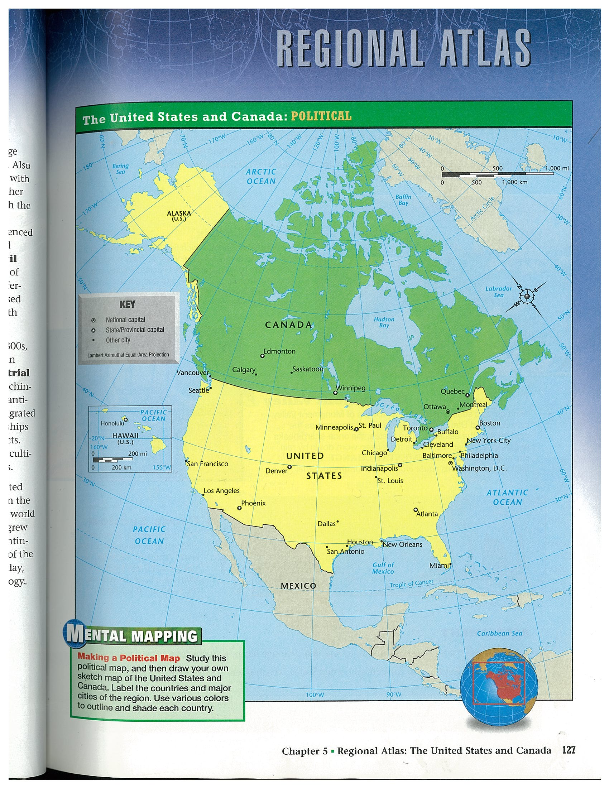

Slide 2
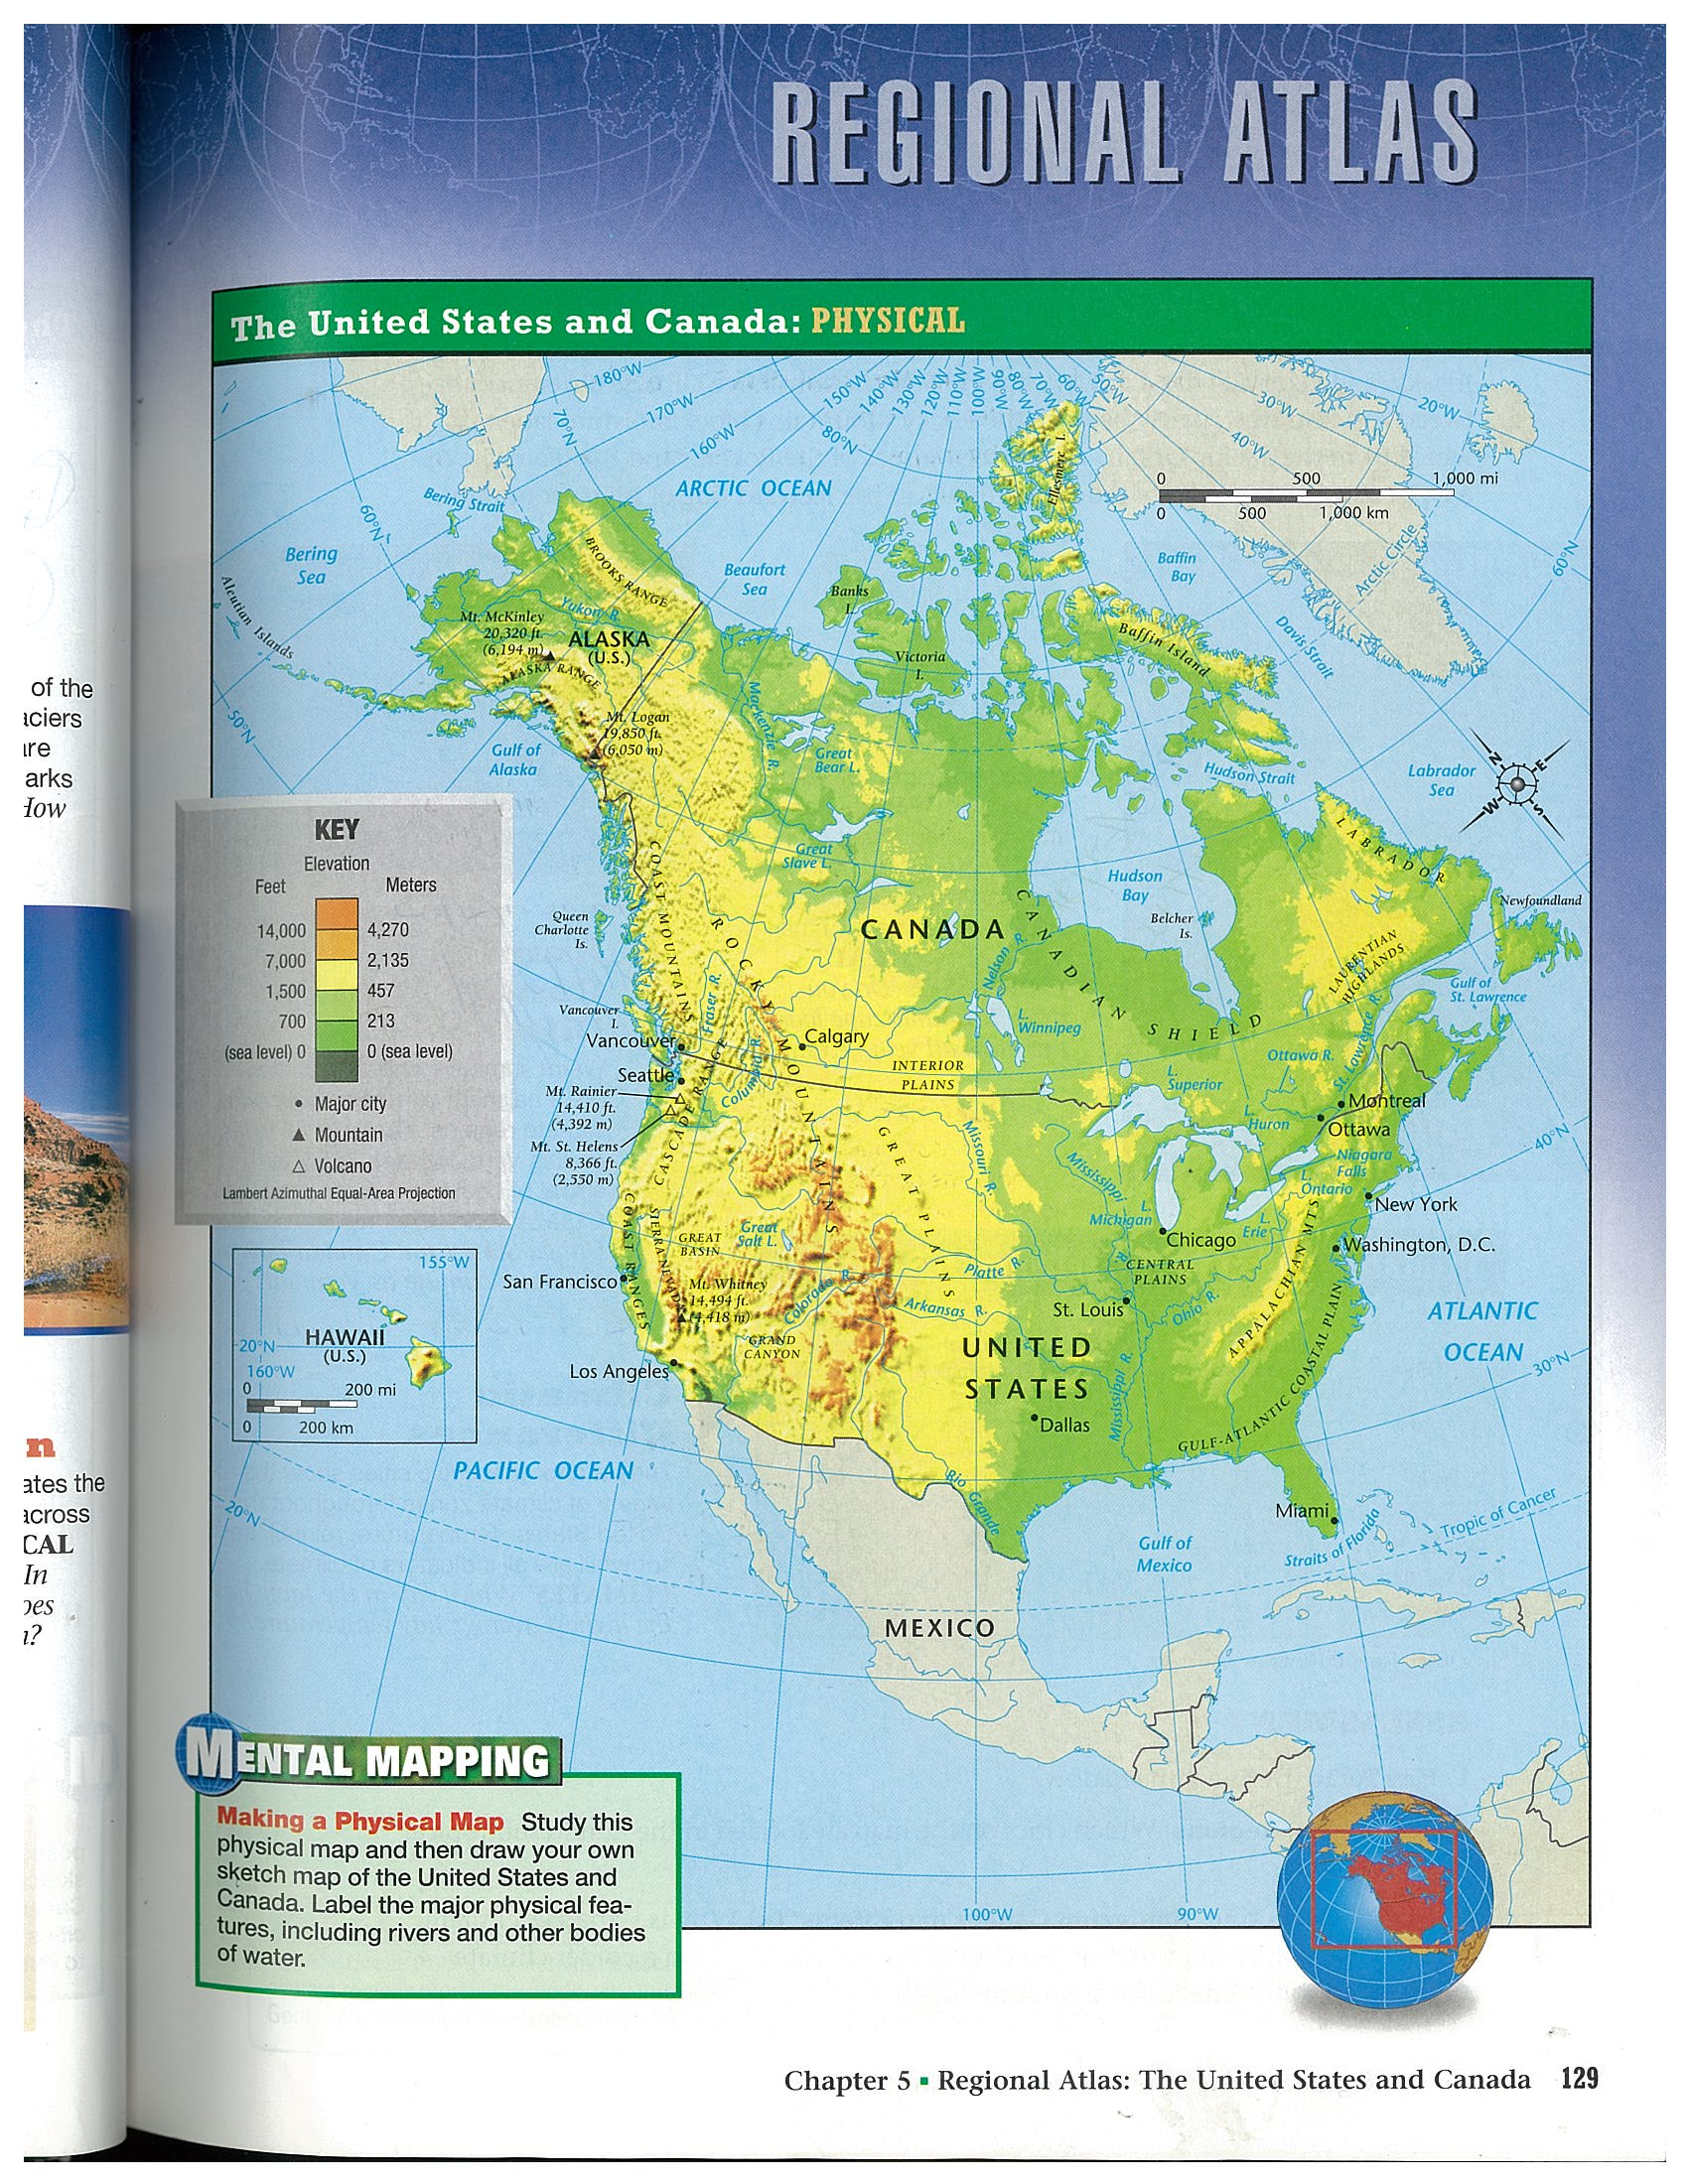

Slide 3
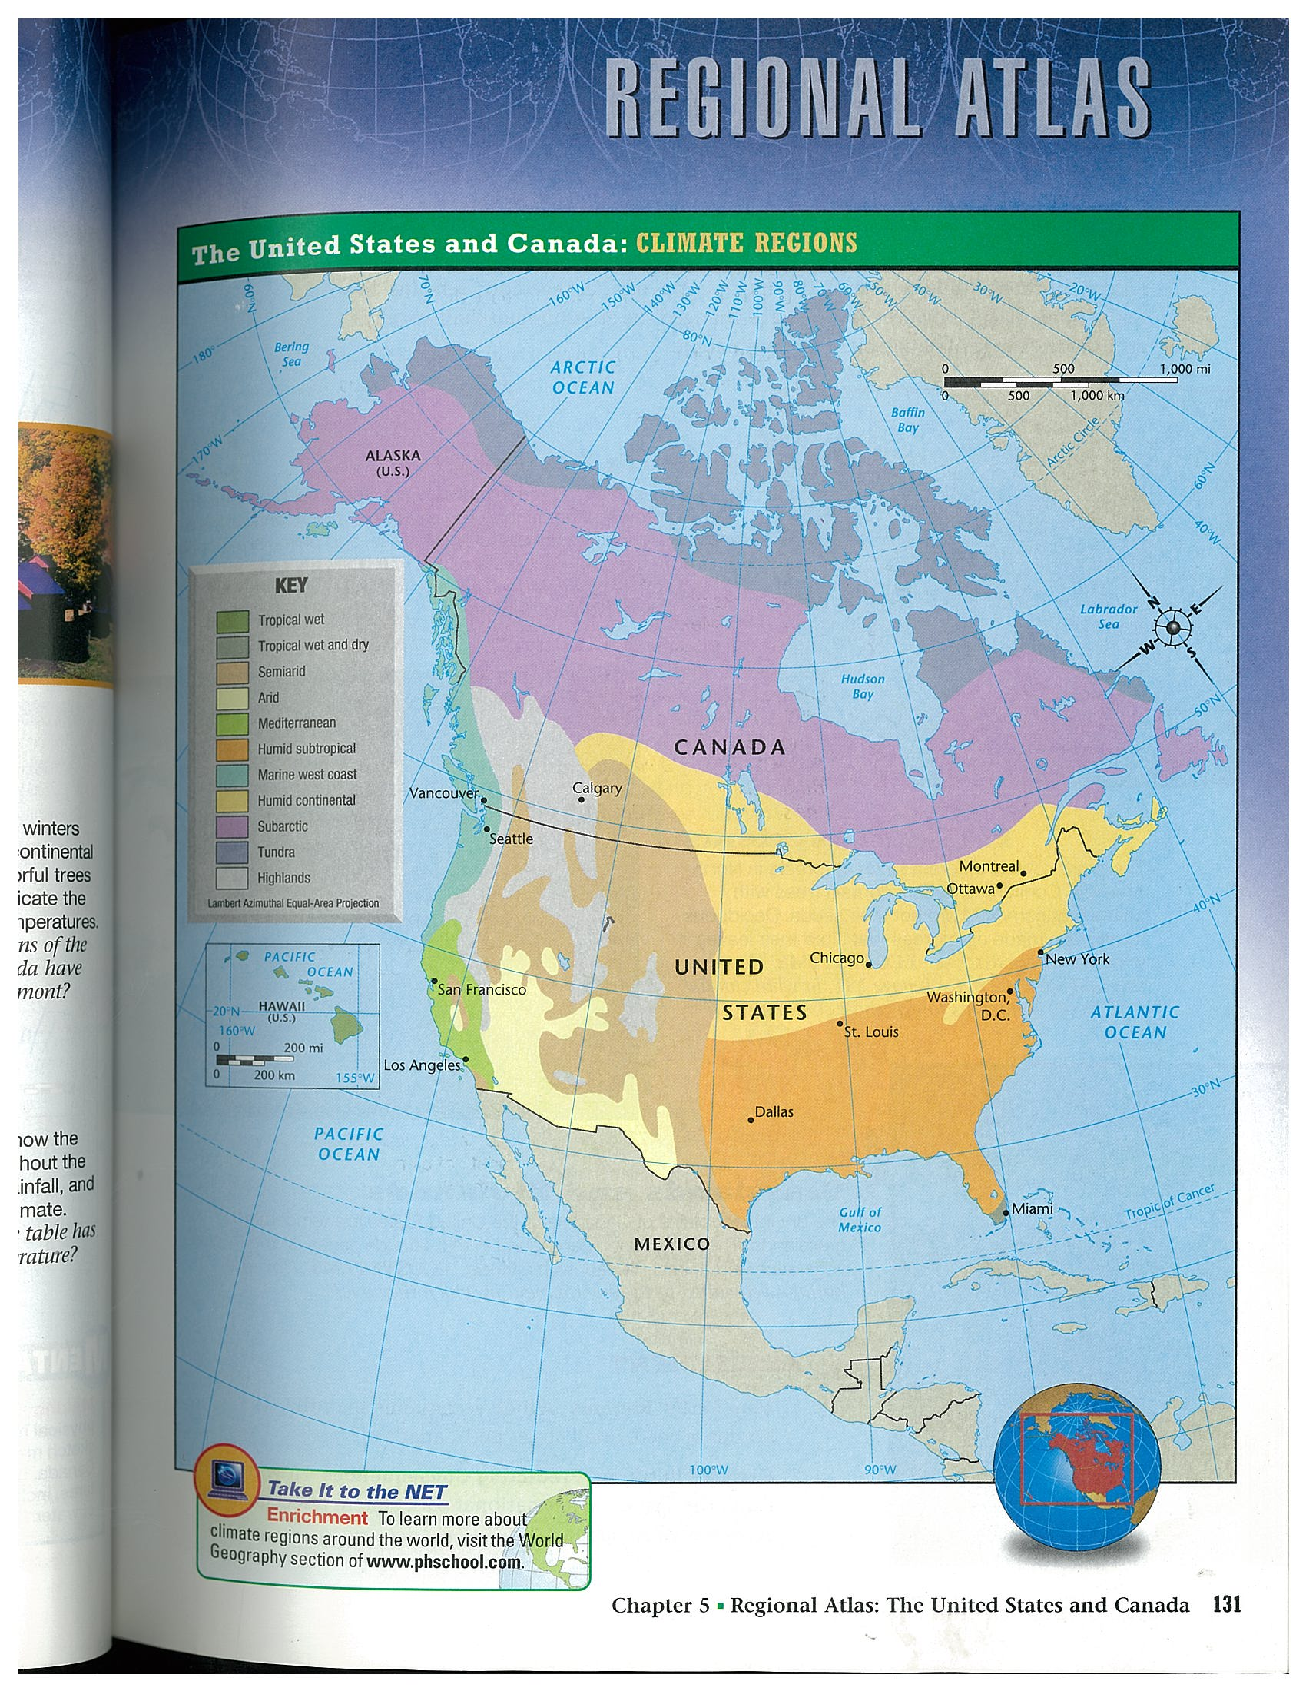

Slide 4
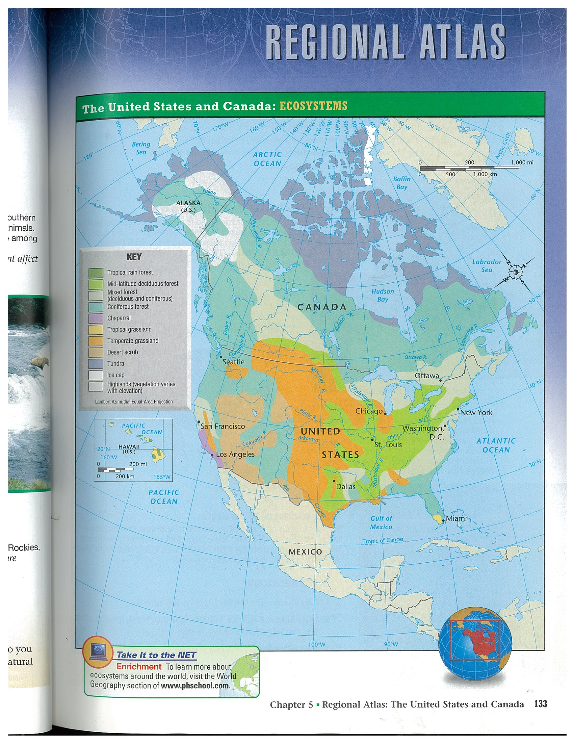

Slide 5
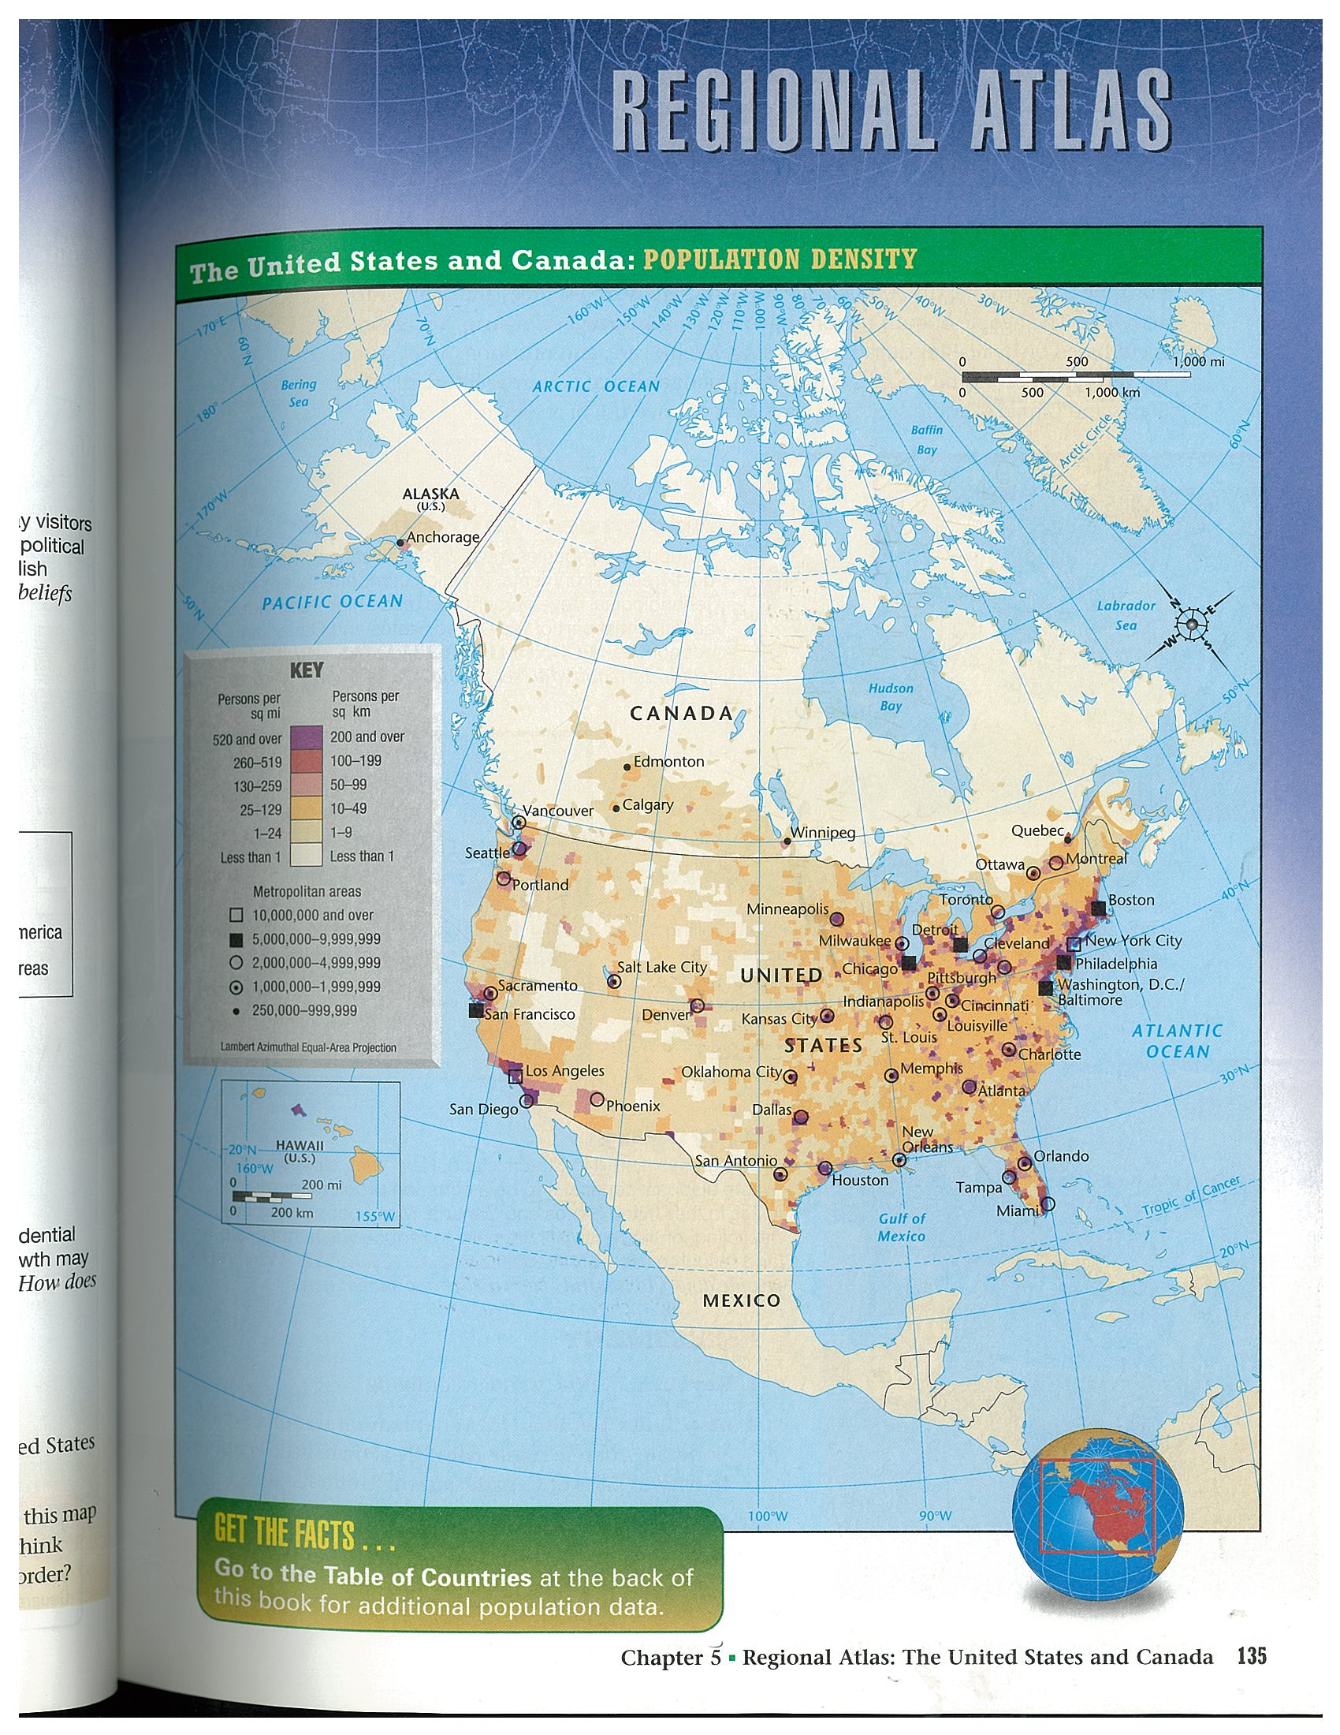

Slide 6
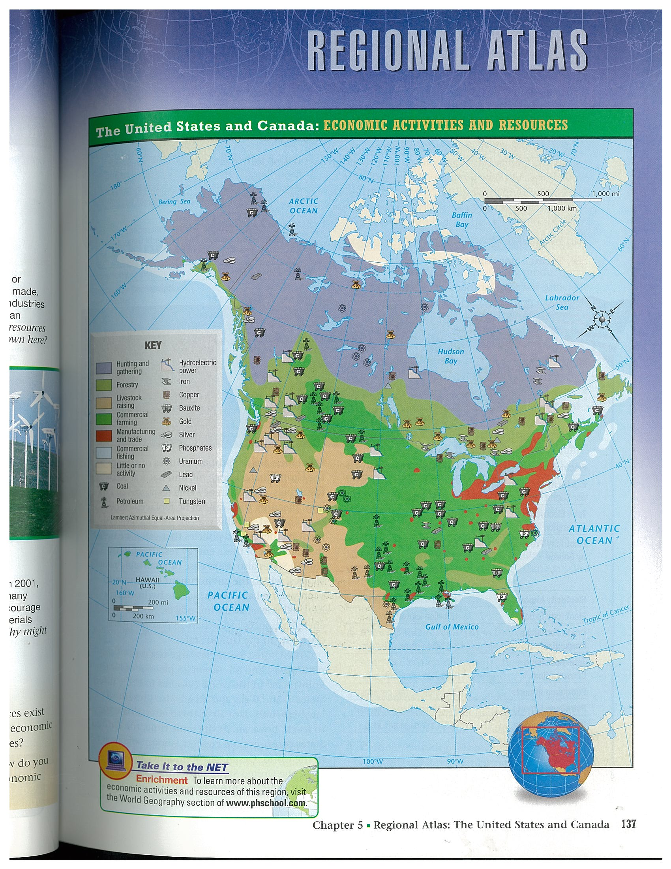

Slide 7
THE FIVE GREAT LAKES ARE WITHIN THE UNITED STATES AND DO NOT BORDER CANADA.
TRUE OR FALSE?

Slide 8
NONE OF THE SAME LANDFORMS ARE FOUND IN BOTH THE UNITED STATES AND CANADA.
TRUE OR FALSE?

Slide 9
THE UNITED STATES LIES FARTHER NORTH THAN MOST OF CANADA.
TRUE OR FALSE?

Slide 10
THE PEOPLE OF THE UNITED STATES AND CANADA HAVE A COMPARATIVELY LOW STANDARD OF LIVING.
TRUE OR FALSE?

Slide 11
THE POPULATIONS OF CANADA AND THE UNITED STATES ARE ROUGHLY EQUAL.
TRUE OR FALSE?

Slide 12
THE INTERIOR SECTIONS OF CANADA AND THE UNITED STATES ARE TROPICAL FORESTS.
TRUE OR FALSE?

Slide 13
THE PEOPLE IN CANADA AND THE UNITED STATES FIND ENERGY IN SHORT SUPPLY.
TRUE OR FALSE?

Slide 14
BOTH CANADA AND THE UNITED STATES HAVE FEW RESOURCES AND LITTLE ACCESS TO TECHNOLOGY.
TRUE OR FALSE?

Slide 15
PEOPLE HAVE NOT CHANGED MUCH OF THE NATURAL VEGETATION AND ECOSYSTEMS IN CANADA AND THE UNITED STATES.
TRUE OR FALSE?

