Slide 1
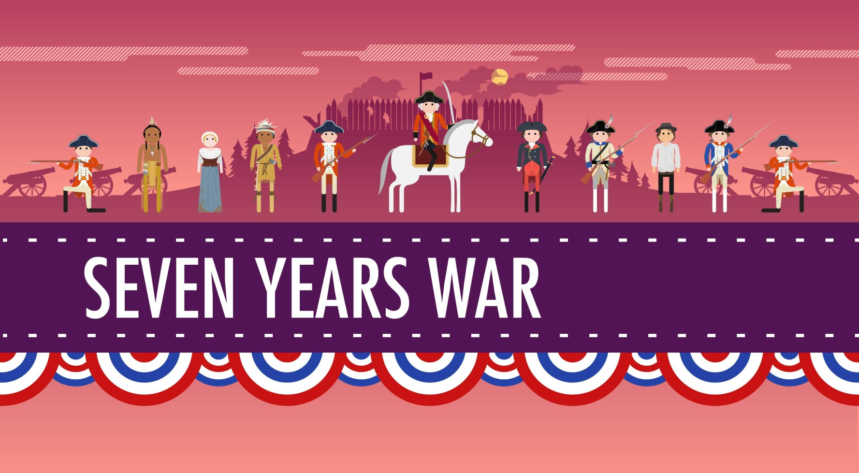
The French and Indian War

Slide 2
BIG IDEAS
Who: English & Indians fought French & Indians
What: French and Indian War (aka Seven Years War, the Fourth Intercolonial War, and the Great War for the Empire)
Where: The bulk of the fighting took place along lakes George and Champlain, in the state of New York near the Canadian border.
When: 1754-1763
Why: English wanted to expand west from the Atlantic coast, but most of the land was already claimed by the French
Outcome: English won control of French land east of Mississippi River in Treaty of Paris.

Slide 3
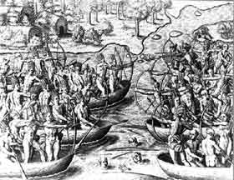
Roots of French and Indian War
1670’s
  New England colonists angry with Wampanoag Indians and their leader (Metacom also known as King Philip) who opposed colonists’ efforts to take his people’s land.
1675
  King Philips War→
  Indians fight colonists
  Lasted for about 1 year
  Many colonists and
  Indians died (including
  Metacom)

Slide 4
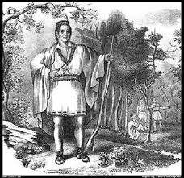
Not all Indians opposed colonists
Some natives fought against Metacom and his forces because they had developed good trade relationships with the colonists.

Slide 5
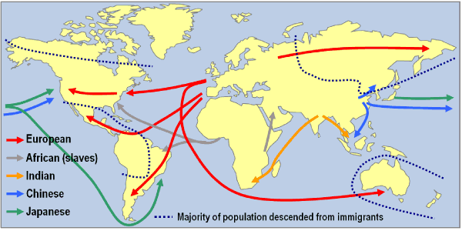
European Colonial Expansion
In the mid 1700’s European nations were competing to create large powerful empires.
North America was in the center of this struggle as countries expanded their colonies.

Slide 6
Colonial Claims to land
S p a n i s h C o l o n i a l C l a i m s
controlled Florida and many of the other islands in the Caribbean.
Spain also had colonies in present day Texas, New Mexico and Arizona.
F r e n c h C o l o n i a l C l a i m s
Claimed large portions of the interior of North America.
French land stretched from the Great Lakes south to the Gulf of Mexico.

Slide 7
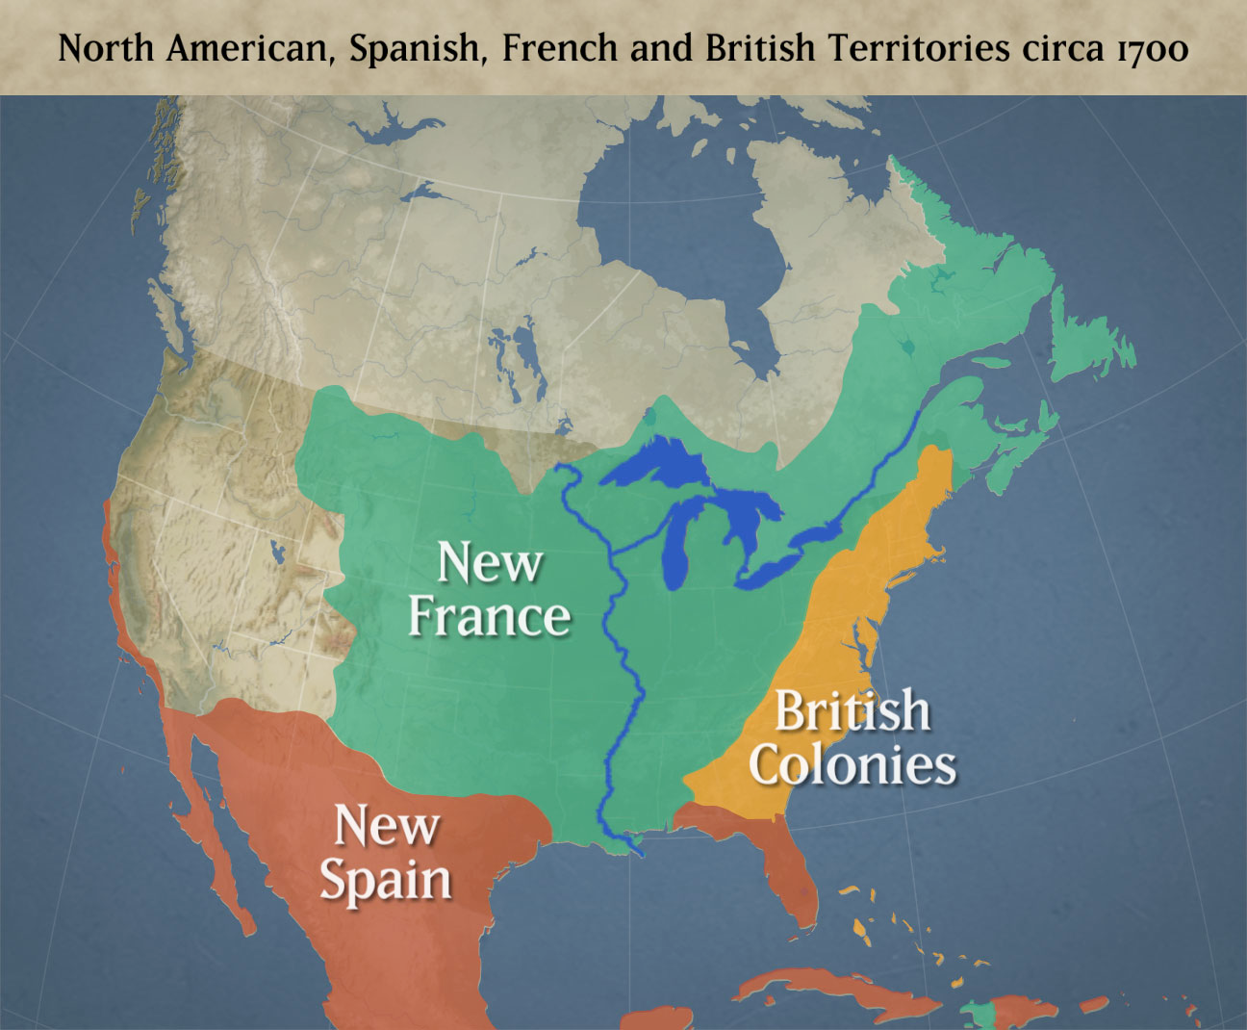

Slide 8

Moving West
At first English settlers were content to remain along the Atlantic coast.
However, by the 1740’s English settlers pushed west into the Ohio Valley in search of furs and farmland.
This brought the English into conflict with both:
French & Indians

Slide 9
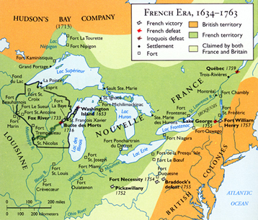
It’s our land
Native Americans had lived in the Ohio Valley for centuries and did not want to give up their land to either French OR English settlers.

Slide 10
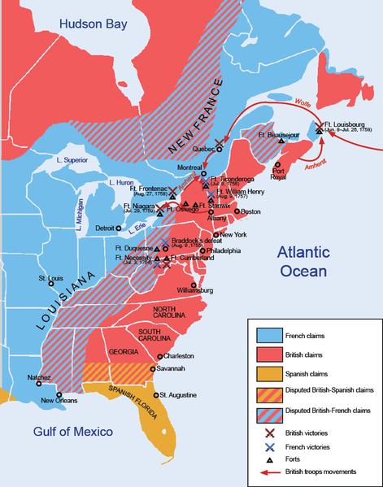
Native Allies
Both the French and the English tried become allies with the Native Americans because the Native Americans controlled the fur trade.
Many Native Americans believed that the only way for them to protect themselves was to take sides with one of the countries in the coming war.

Slide 11
Reason to Side With the…..
Let’s Discuss!!!

Slide 12
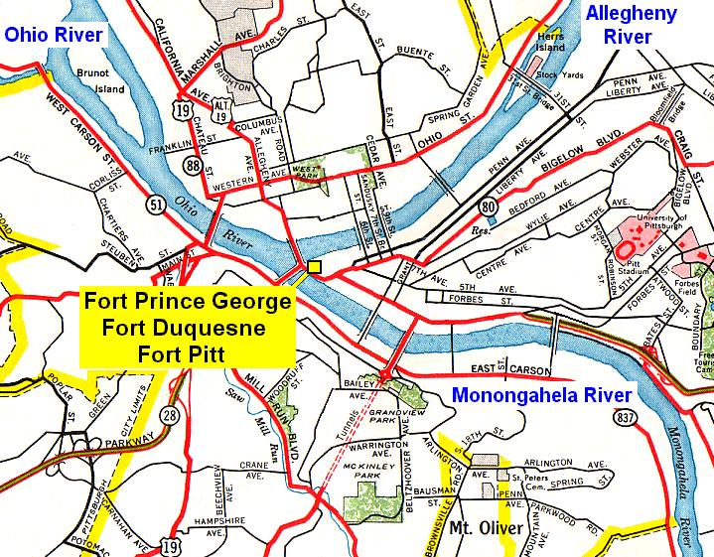
Opening Shots
Robert Dinwiddie, Lieutenant Governor of Virginia, wanted to protect the frontier of Virginia from French advances.
He wanted to build a fort where the Monongahela River and Allegheny River came together to form the Ohio River. He sent 150 men to build the fort under the command of a man named Major George Washington.

Slide 13
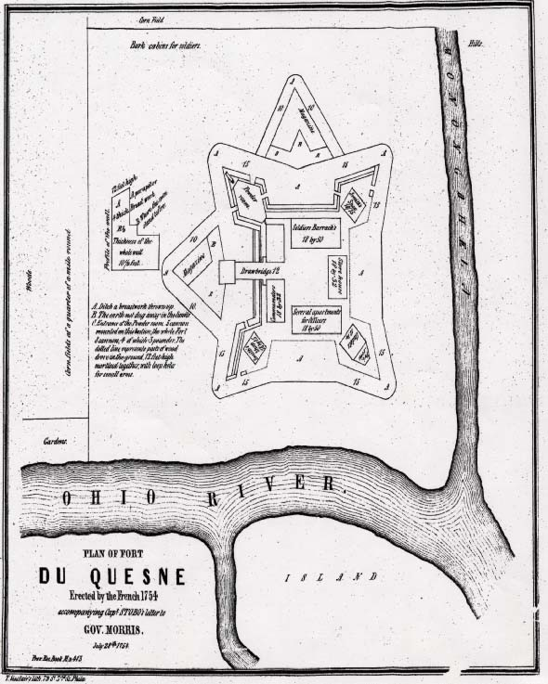
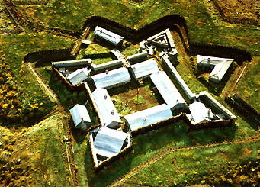
Fort Duquesne
To Washington's horror he realized that the French had already built a fort in the exact spot on which he was planning to build his fort!

Slide 14
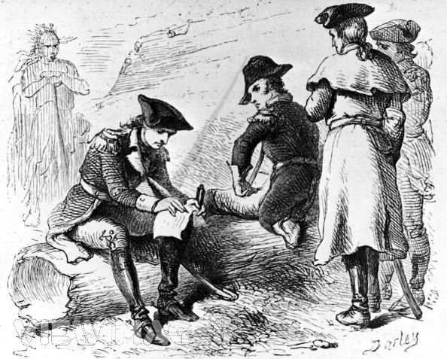
Washington’s Surprise
Washington did not give up on his mission. He continued toward Fort Duquesne.
Along the way he defeated a small French scouting party.

Slide 15
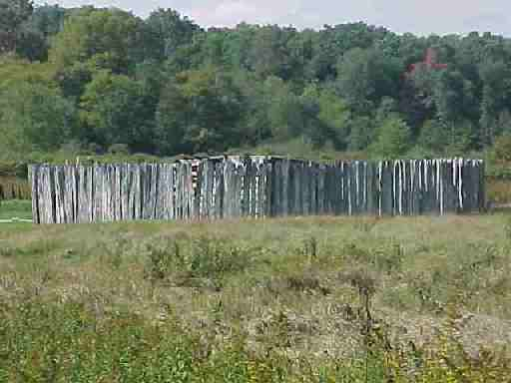
Fort Necessity
Washington was warned of an imminent French attack so he ordered his men to construct a crude defensive fort that they named Fort Necessity.

Slide 16
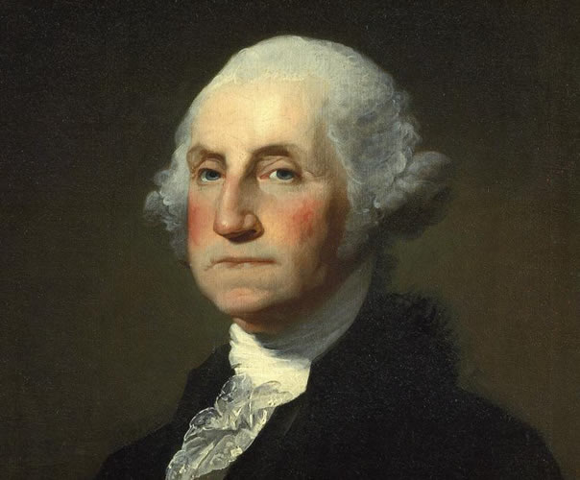
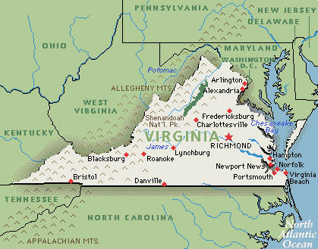
Outcome of the fighting
Though Washington defeated a small group of French soldiers, Washington was outnumbered so he surrendered and returned to Virginia.

Slide 17
These events marked the beginning of
The French and Indian War
Battle at Fort Necessity

Slide 18
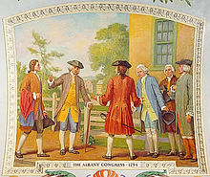
Events of the French and Indian War
The Albany Congress
While Washington was fighting the French in the Ohio country, delegates from seven colonies gathered in Albany, New York.
The delegates wanted to plan a united defense in the event that the French attacked the colonies.

Slide 19
What is a delegate?
A person sent or authorized to represent others, in particular, an elected representative sent to a conference.
WHAT?!?
A group of people, like you, might send a delegate, or classmate, to talk to me about negotiating an extension on a project.
Sending that person as a delegate means that you (as a class) are trusting that person to make a decision that will be in the best interest of the group.
(i.e. they can make a decision without actually asking you)

Slide 20
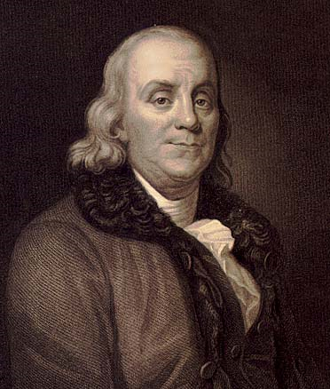
Albany Plan of Union
Delegates felt the colonies would need to work together in order to defeat the French.
A delegate from Pennsylvania, Benjamin Franklin, proposed the Albany Plan of Union.
The Albany Plan of Union would create a Grand Council with representatives from each of the thirteen colonies.
The council could raise taxes in order to support an army.

Slide 21
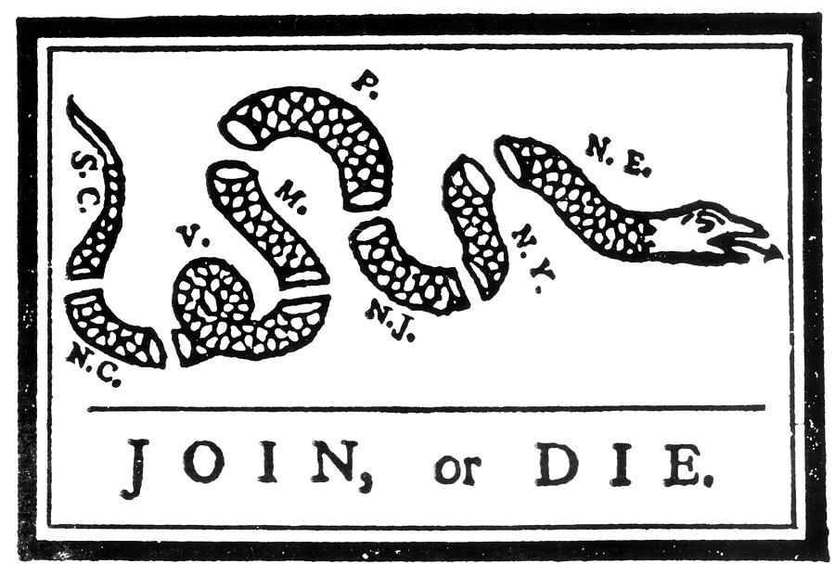
The delegates voted in favor of the Albany Plan of Union. The plan was then taken to each colonial legislature – however, not a single one of them approved the plan. None of the colonies were willing to give up any of their authority. Although it failed, this was the first step toward freeing the colonies.

Slide 22

French Strengths and Advantages
The English colonies could not agree on a united defense plan while New France had a unified government.
The French had the support of more Native Americans.

Slide 23

English Strengths and Advantages
The English colonies were clustered along the coast which made them easier to defend.
The population of the English colonies was 15 times greater than New France.
The English had a superior Navy.

Slide 24
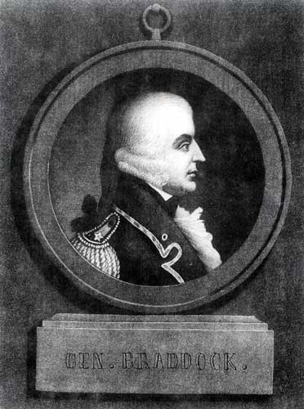
General “Bulldog” Braddock
In 1755, General Edward Braddock was given the task to lead an attack on Fort Duquesne.
Braddock was a stubborn and determined leader who was nicknamed “Bulldog” behind his back.
He was an experienced and successful general in Europe and he boasted that he would “sweep the French from the Ohio Valley”.
However he knew little about fighting in the wilderness of North America.

Slide 25
A tough road for Braddock
Braddock marched toward Fort Duquesne with his men. (note: his men were terrified of an attack because they heard that Indians were scalping enemies.)
They marched on an old Indian trail, but had to build/expand it into a road to fit their wagons and 2000 men.
It took nearly 1 month to build the road that stretched over 100 miles.

Slide 26
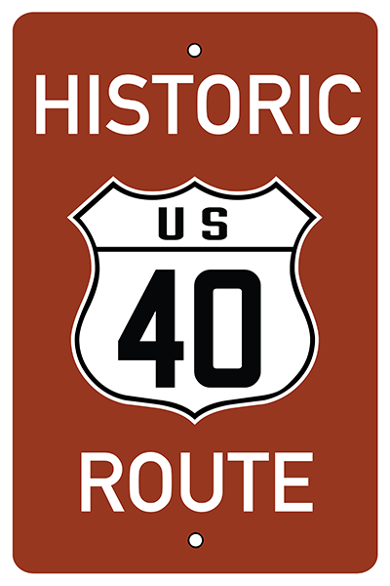
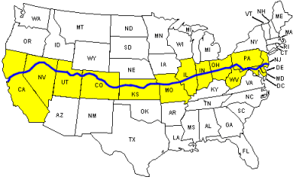
Did you know?
The road Braddock and his men built was 12 feet wide and 110 miles long
50 years later it was financed by Congress as the first National Road.
This road is now called U.S 40 and is still here today.

Slide 27
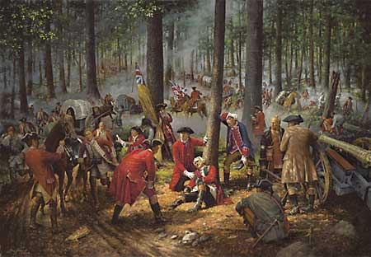
Disaster for the British
Just before arriving at the Fort, they were surprised by a troop of French and Indians who came to stop them.
Braddock was shot in the chest and later died of his wounds.
Braddock
Washington

Slide 28
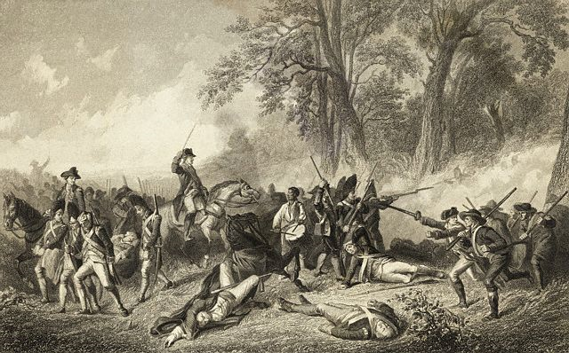
Ouch!
Almost half of Braddock’s men were killed or wounded in the attack.
Washington led then survivors back to Virginia.

Slide 29
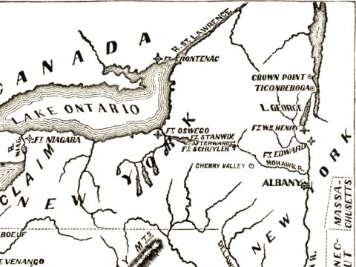
What’s next for the British?
During the next two years, the war continued to go poorly for the British.
British attacks against French forts like Fort Duquesne were failures.
Meanwhile the French captured the Fort Oswego and Fort William Henry from the British.
Fort Oswego
Fort Wm Henry

Slide 30
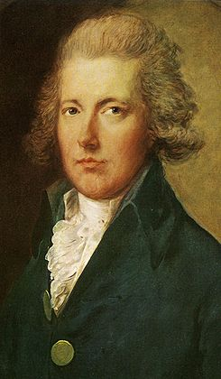
Outcome of the French and Indian War
A Change in Momentum
In 1757, William Pitt came to power in England.
The French and Indian War was raging all around the world.
Battles were being fought in Europe, North America and Asia.

Slide 31
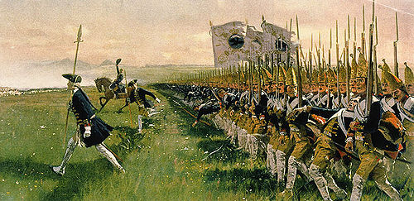
William Pitt determined to win
Pitt declared that if the British could win the war in North America then they could focus on victory in other parts of the World.
Pitt sent large numbers of troops and his best generals to America.
He promised large payments to colonists who fought in the army or provided military supplies.

Slide 32
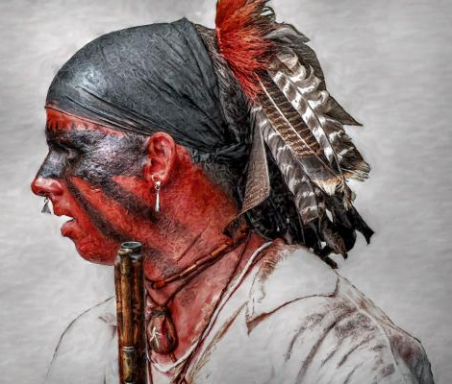
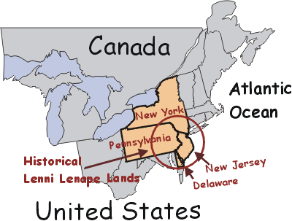
Delaware and Fort Pitt
The English also won more support from Native Americans.
The French were supported in the Ohio country by the Delaware Indians.
The British Iroquois allies convinced the Delaware Indians at Fort Duquesne to abandon the French.
Without Delaware support the French could not defend the fort.
The British acted quickly and seized the fort which they renamed Fort Pitt.

Slide 33
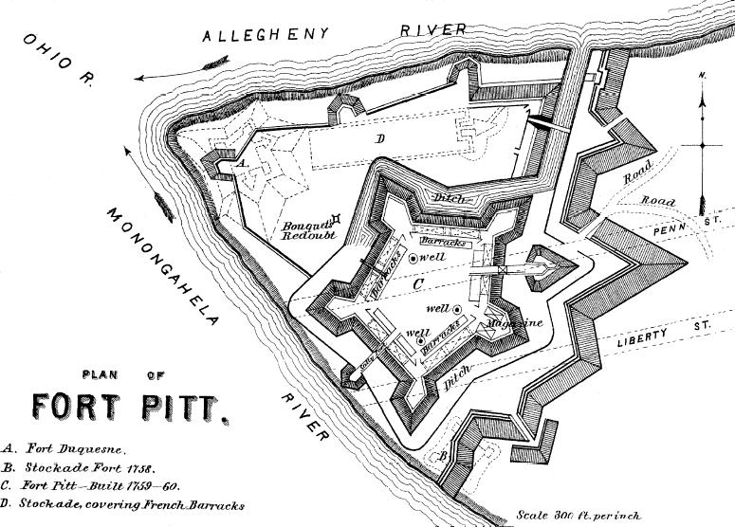

Slide 34
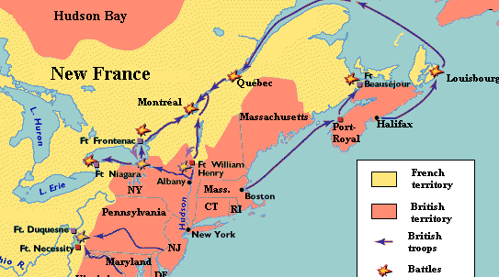
Continued success
The British continued their success.
They captured the French forts Niagara, Crown Point and Ticonderoga and captured the cities Louisburg and Quebec.

Slide 35
Quebec falls
The fall of Quebec ended the war in the colonies.
France had lost control of its territory in North America.
Fighting in Europe continued for three more years until the treaty of Paris was signed.
Under this treaty England gained control of all the French territory east of the Mississippi.

Slide 36
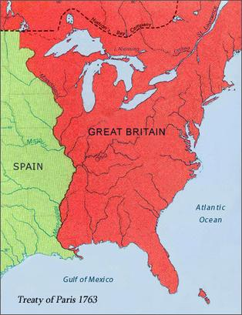
Britain’s new territory
Spain gave Florida to England and gained all the French territory Spanish Territory west of the Mississippi.

Slide 37

Peace for now
Peace returned 1763 but it would be short.
Only a few years later another war would break out this time between England and its own colonies.

Slide 38
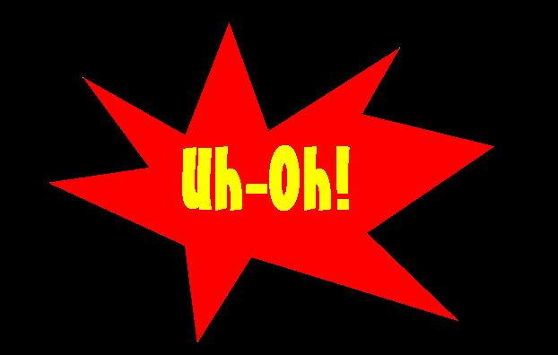
New Troubles in North America
Following the French and Indian War, England found itself deeply in debt.
Not long after the English victory new problems began to appear in the English colonies.

Slide 39
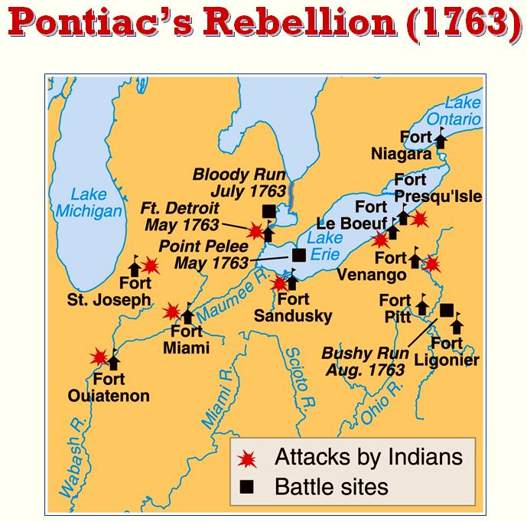
Pontiac’s War (or Pontiac’s Rebellion)
Following the French and Indian war, relations with Native Americans worsened.
The British did not respect Native American customs as the French had done.
This led to much resentment.

Slide 40
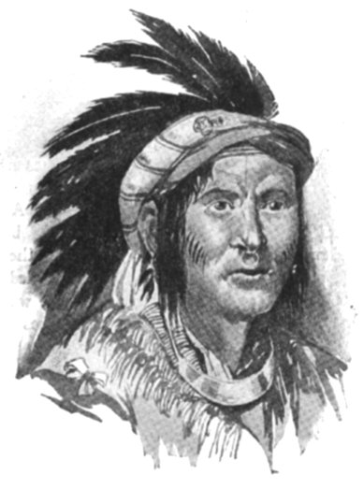
Pontiac’s War (or Pontiac’s Rebellion)
Unhappy Native Americans found a leader in a man named Pontiac, who led a revolt against English colonists settlers who were creeping into the Ohio Valley.
This became known as Pontiac’s War.
Pontiac captured several forts along the frontier but ultimately he was defeated.

Slide 41
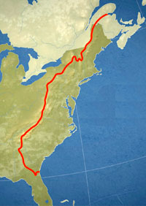
Proclamation of 1763
The French and Indian War was expensive; England wanted to avoid the possibility of another war.
The British issued the Proclamation of 1763 which closed off the Ohio Country to English settlers.
No longer were English settlers allowed to settle West of the Appalachian Mountains.
Settlers who had already established farms were ordered to leave.

Slide 42
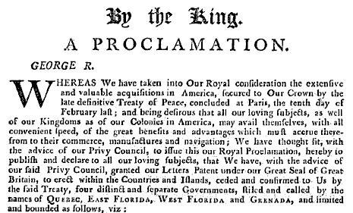
Royal Proclamation of 1763

Slide 43
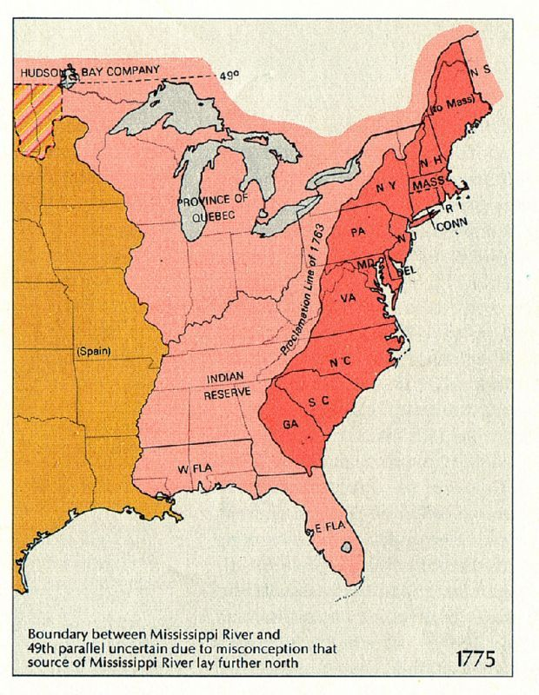
Proclamation of 1763
Boundary that closed off English settlers to westward expansion

Slide 44

Taxes . . .
In section 5, you will learn:
  Great Britain won the French and Indian War, but it was very expensive and they still had to pay for it.
  GB maintained an army in North America to prevent future Indian attacks.
  Parliament and the Prime Minister (George Grenville) began issuing taxes to help raise money in the colonies.
  The colonists were not happy…

