Slide 1
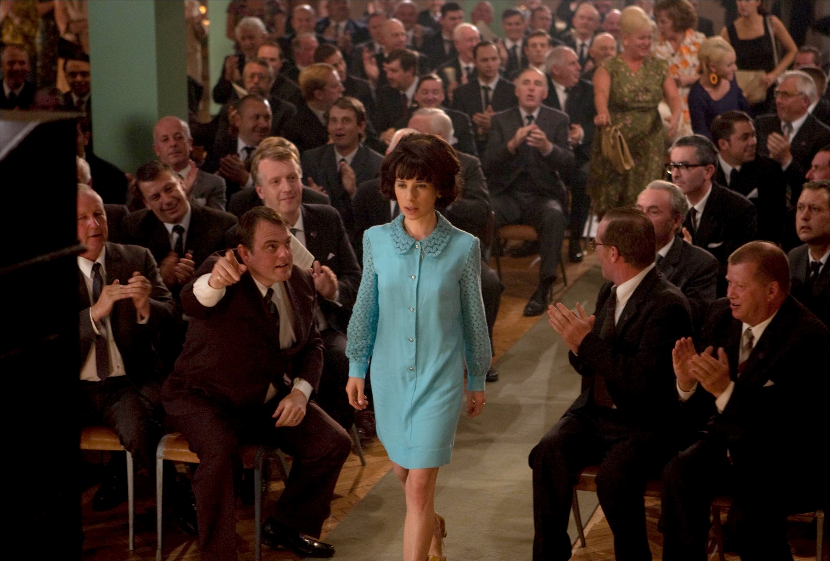
North
Women and Reform

Slide 2
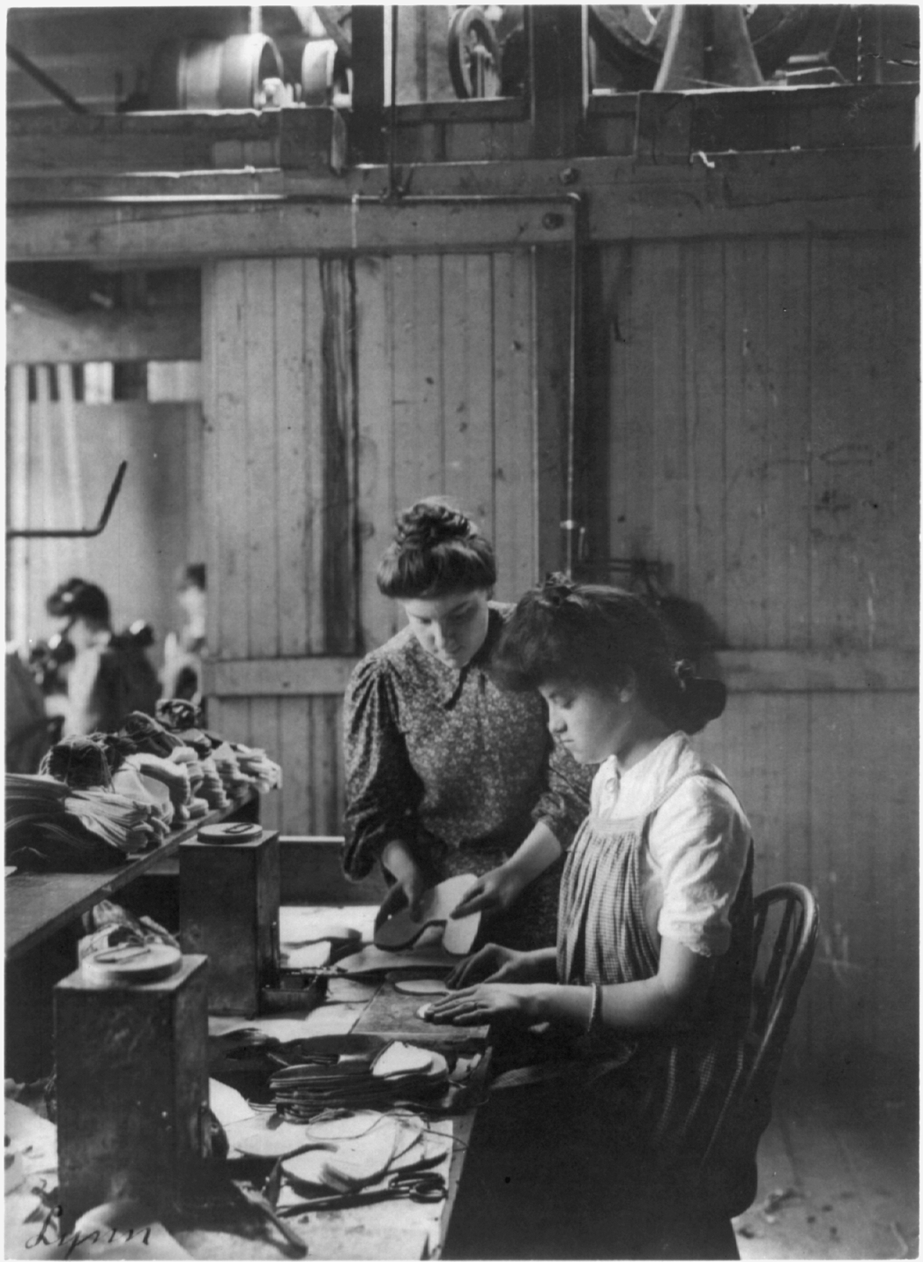
WAGE$
The Industrial Revolution allowed women to make some important changes for themselves too.
Women were, for the first time, given the opportunity to earn wages for themselves. This created a sense of independence.

Slide 3

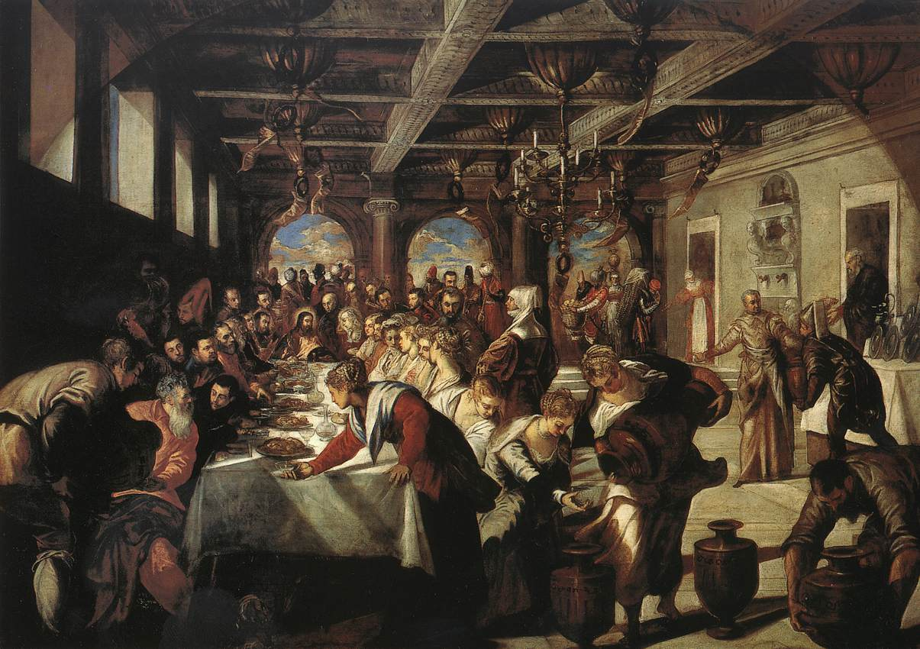
This was important because women faced several hurdles in the 1800’s.
Women could not vote or hold office.
When a woman married, all of her property became her husband’s property.
A working woman’s wages belonged to her husband.
A husband had the right to make decisions for his wife.

Slide 4
Politics
Because of an increased level of independence gained through the Industrial Revolution, women developed a strong voice in politics.

Slide 5
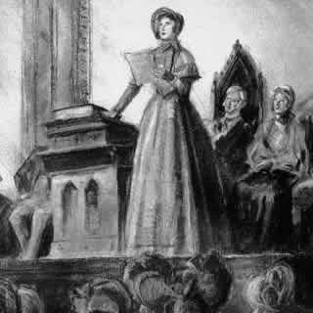
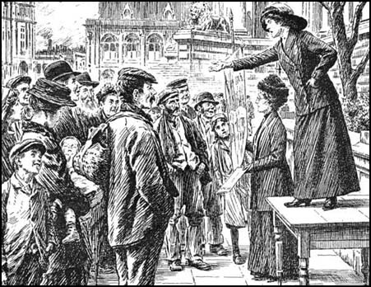
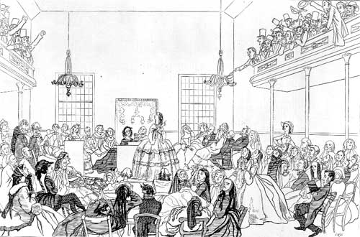
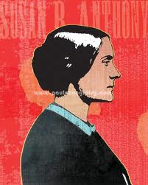
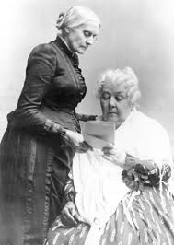
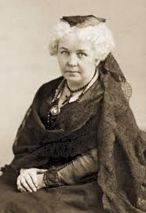

Leaders
The Seneca Falls Convention marked the first time that women in the United States organized as a group to promote their rights.
Susan B. Anthony and Elizabeth Cady Stanton were two women who worked tirelessly to increase women’s political independence.

Slide 6

Reform
In addition to women’s rights, there were also many other reform movements during this period.
Social reform is an organized attempt to improve what is unjust or imperfect in society.

Slide 7

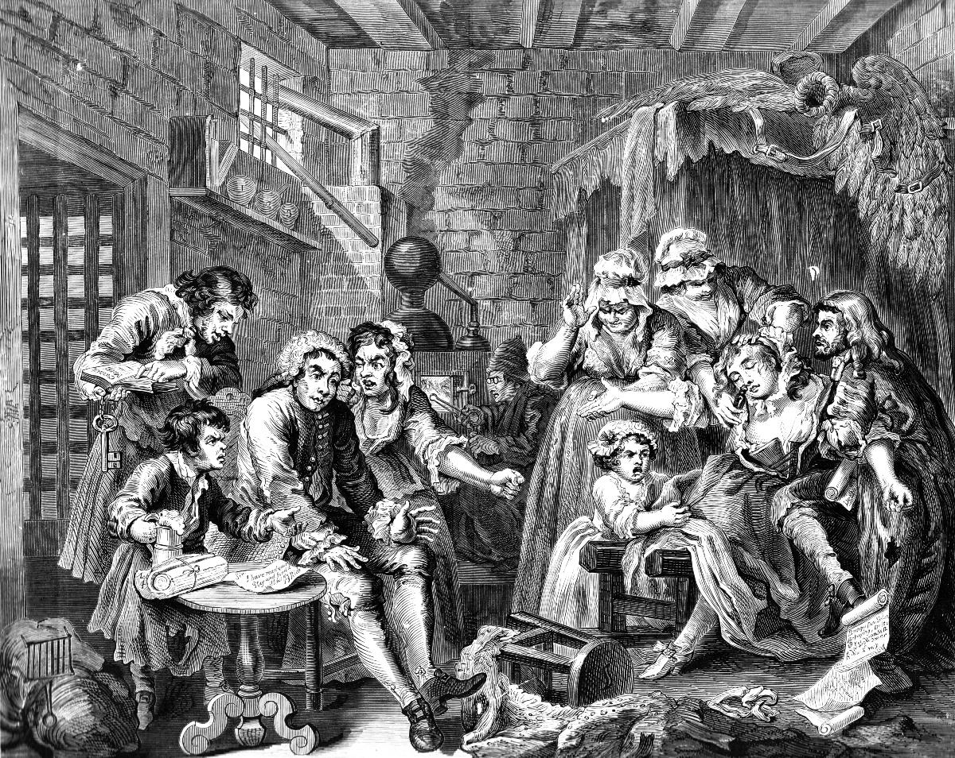
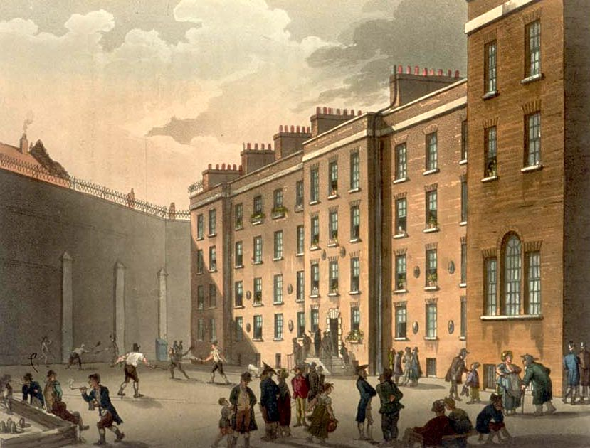

Prison System
In the 19th century the prison system was very harsh.
Most prisoners (5 out of every 6) were debtors, people who could not pay the money they owed. Once in prison they couldn’t do anything to pay back the money they owed.
Eventually states stopped treating debtors as criminals.

Slide 8
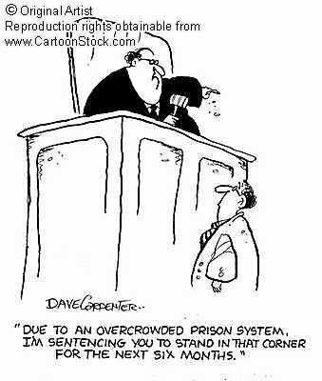
Prison System
Overcrowded prisons became more focused on reforming the prisoners.
Mentally ill were taken out of prisons and put in hospitals.

Slide 9

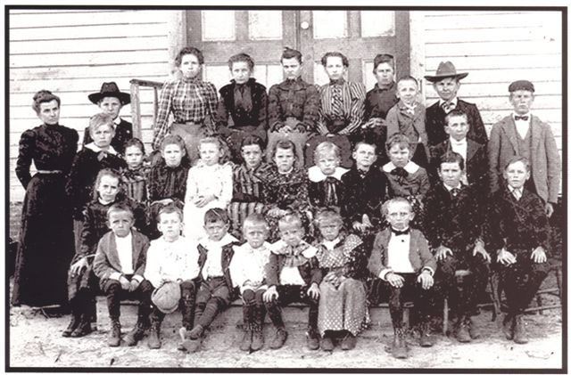
Education
In addition to changing the prison system, people began to call for reform in education.
During this period, children from all backgrounds were put into public, tax supported, schools.

