Slide 1
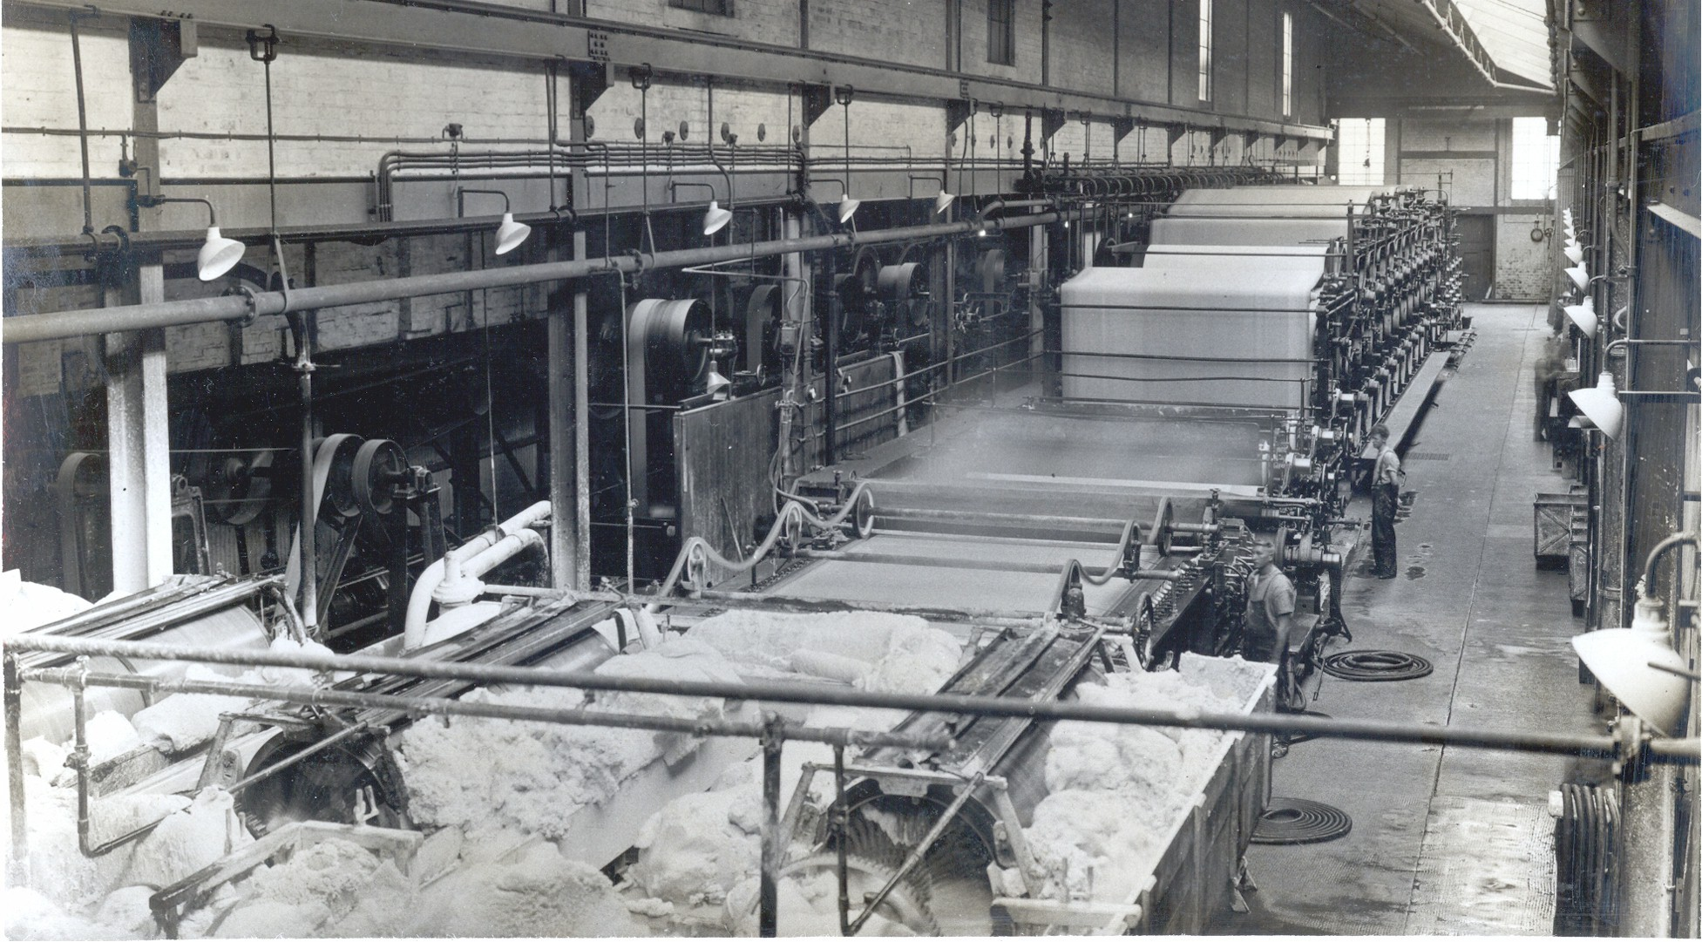
NORTH
Industrial Revolution

Slide 2
In the Old Days…
In the 1700’s most things (food, clothes, tools) were made in little shops that were run by skilled artisans.

Slide 3
What is an Artisan?
An artisan is someone who has trained for many years to do a specific job.

Slide 4
Artisans
Artisans were very good at making high quality goods, but each job was expensive and took a lot of time.

Slide 5
British Inventors
Towards the end of the century though, British inventors started coming up with ideas about how to produce things faster.
They built machines that could do the same work as artisans.

Slide 6
Inventors
At first inventors used water or wind to propel (run) their machines.

Slide 7
Steam
Soon though, they discovered that steam could help run the machines.

Slide 8
Machines
Eventually the machines became so advanced that they could do the same amount of work that normally took many artisans to do at a much faster pace.

Slide 9
Mass Production
These machines followed the principle of mass production.
Mass Production means to produce a large number of goods that are exactly alike.

Slide 10
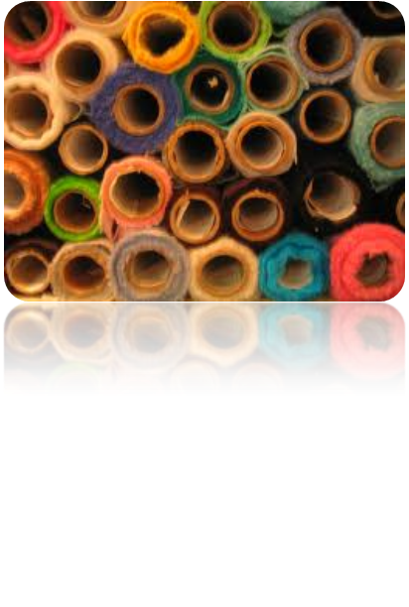
Textiles
The textile (or cloth making) industry was the first industry to be transformed

Slide 11
Spinning Jenny
James Hargreaves invented a machine he called The Spinning Jenny that could weave thread much faster than people in the past could.

Slide 12
Factories
Rich men began buying these and other machines and put them into building they called factories.

Slide 13
Training
Because it didn’t take much training to teach people how to run the machines they could hire unskilled workers and pay them very low wages.

Slide 14
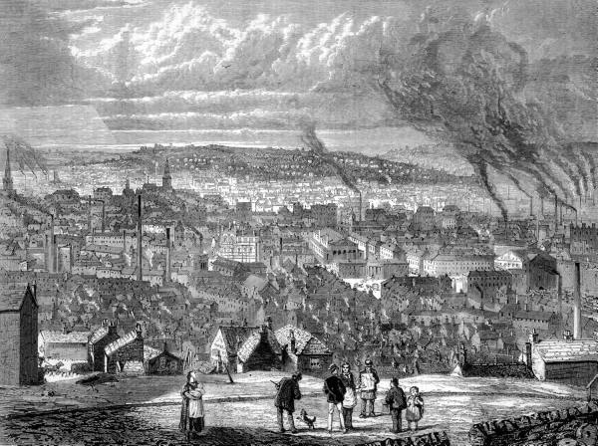
Factories
Instead of working alone in their homes, many workers went to work where the machinery was—Factories. This new system of work is called the factory system.

Slide 15
Industrial Revolution
These factories, filled by unskilled workers, began putting the old artisans out of business.
We call this the
INDUSTRIAL REVOLUTION

Slide 16
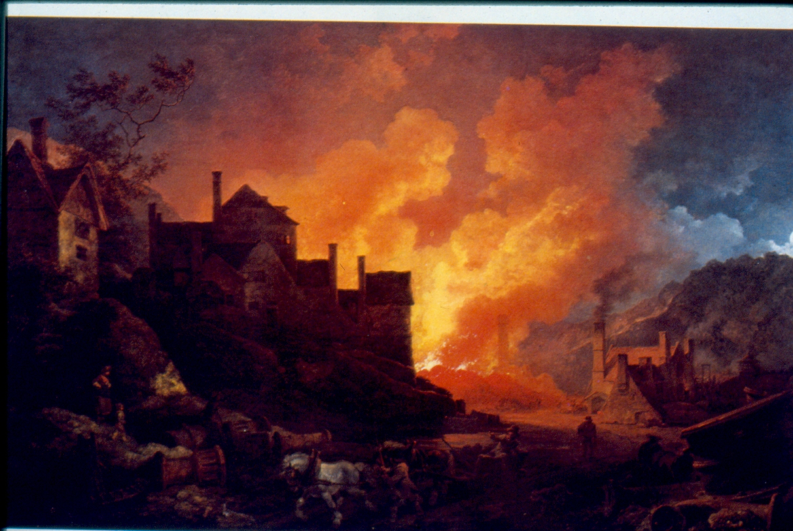
Industrial Revolution
Gradual process by which machines replaced hand tools, and steam and other new sources of power replaced human and animal power.

Slide 17
Samuel Slater
Britain wanted to keep the factory system a secret and produced a law that said no one can take plans for the machines out of the country Samuel Slater broke the law by memorizing the designs for mills and helped build the first successful textile mill in North America.

Slide 18
Improvement
Once the Industrial Revolution had spread to America, inventors on this side of the Atlantic began improving on the system

Slide 19
Interchangeable Parts
Eli Whitney proposed that Identical interchangeable parts should be used so that if part of a machine broke it could be replaced.

Slide 20
Lowell Mills
Lowell mills combined spinning and weaving under one roof as opposed to the English model of multiple factories.

Slide 21
Railroads
Eventually factory owners wanted a way to transport goods from their factories to other cities.
They built railroads and canals to link factories and cities together.
The railroads and canals allowed factory owners to transport large amounts quickly and cheaply.

Slide 22
Erie Canal
The Erie canal was built in order to increase the amount of trade in the North.
Due to the Erie Canal, the cost of shipping goods dropped to about one tenth of what it had been and helped make New York City a commercial center.

Slide 23
Telegraph
Not only were goods being transported across the country but information as well.
Samuel Morse invented the telegraph which could send information over wires across great distances.

Slide 24
How did it send information?
The Telegraph sent pulses of electric current through a wire.
The operator tapped a bar that controlled the length of each pulse.
At the other end of the wire, these pulses were changed into clicking sounds.
A short click was a dot and a long click was a dash
Different combinations of dots and dashes were used to stand for letters of the alphabet
The system was known as MORSE CODE

