Slide 1
Unit 1.3 Lesson 4
Jamestown

Slide 2
Objective
SWUT: The English colony at Jamestown survived hard times and set up a representative government.

Slide 3
Jamestown
In 1585, Sir Walter Raleigh sent 100 men to found a colony in North America.

Slide 4
Jamestown
They landed on Roanoke Island off the coast of North Carolina and began to build.

Slide 5
Jamestown
The next year, the colonies, short of food and surrounded by hostile natives, returned home.

Slide 6
Jamestown
In 1587, Sir Walter sent John White with a group of men, women, and children to re-found the colony.

Slide 7
Jamestown
John White returned to England to obtain more supplies. When he returned in 1590 the colonists had disappeared.

Slide 8
Jamestown
In 1607, the Virginia company received a charter from King James I to found a new colony. 105 colonists set out for America.

Slide 9
Jamestown
This time they moved further inland and founded the colony of Jamestown in Virginia.

Slide 10
Jamestown
The first site was in a malarial swamp and some of the settlers got sick. They soon moved, but it was not a good start.

Slide 11
Jamestown
At the new site they constructed a fort but didn’t plant enough food, instead they spent too much time looking for gold.

Slide 12
Jamestown
Were it not for the leadership of Captain John Smith, this colony would have failed as well.

Slide 13
Jamestown
While he was exploring the area around Jamestown, the Indians captured John Smith.

Slide 14
Jamestown
At first, he wrote that the Indians treated him well, but 17 years later he changed his story claiming that they were going to execute him but that he was saved by the chiefs daughter, Pocahontas.

Slide 15
Jamestown
Captain Smith forced the settlers to work for food and began to trade with Powhatan, the local chief.

Slide 16
Jamestown
When the natives refused to trade, the settlers began taking what they needed by force.

Slide 17
Jamestown
Pocahontas was taken prisoner and later married another settler named John Rolfe and peace was restored for a time.

Slide 18
Jamestown
The colonist drove John Smith out and quit working. 4 out of 5 of the colonists died that winter. This period became known as the starving time.

Slide 19
Jamestown
The colony grew slowly as the deaths were replaced by new arrivals from England.

Slide 20
Jamestown
In 1612, the Jamestown colonists began growing tobacco. This cash crop ensured the survival of the colony.

Slide 21
Jamestown
The Virginia company went broke and in 1619 the Jamestown colonists established the first representative government in America, the House of Burgesses.

Slide 22
Jamestown
At first, the colonists had greater freedoms than even the common man in England. All men had the right to vote.

Slide 23
Jamestown
By 1624, there were over 1,000 men in Jamestown, though there were less than 300 women.

Slide 24
Jamestown
The demand for tobacco caused a shortage of workers. Property owners would pay for a worker to come from England. These “indentured servants” would work for 7 years and pay off this debt.

Slide 25
Jamestown
By 1700 the laws were changed so that Africans could be kept in slavery for life, and only free, white, male property owners could vote.

Slide 26
Let’s take a moment now to stand and stretch…
Before moving on to the next excitement!!!

Slide 27
Unit 1.3 Lesson 5
Plymouth

Slide 28
Objective
SWUT: The Pilgrims founded Plymouth Colony in order to practice their religion freely.

Slide 29
Plymouth
For millennia the rulers of the old world had tried to maintain control of peoples’ beliefs. Those who refused to practice the established religion were persecuted or executed.

Slide 30
Plymouth
In England, the established church was the Protestant Anglican Church. They were actively persecuting another group of protestants who called themselves separatists. We know them today as Pilgrims.

Slide 31
Plymouth
In 1620, more than 100 people, including Pilgrims, boarded the Mayflower and sailed for America.
They landed at Cape Cod in today’s Massachusetts, and named it Plymouth.

Slide 32
Plymouth
Having landed well outside the boundaries of Virginia, the 41 adult males drew up their own charter for governing the new colony called the Mayflower Compact.

Slide 33
Plymouth
Although they left England seeking religious freedom, the Pilgrims were no more tolerant of other religious beliefs than the Anglicans had been.
Soon they were persecuting religious dissenters.

Slide 34
Plymouth
The place where they landed and settled had been cleared, but no one was living there.
They later discovered the tribe that had lived there had all died of disease.

Slide 35
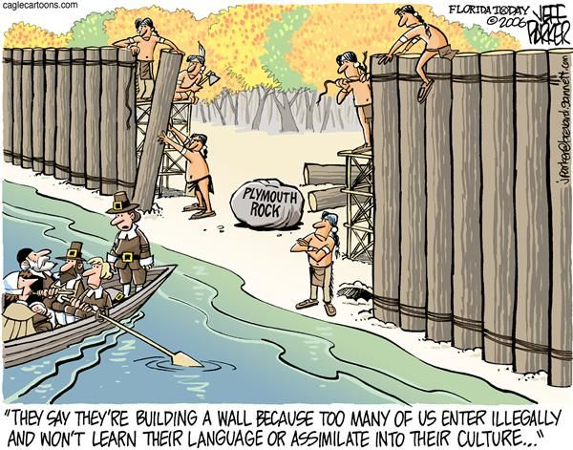

Slide 36
Plymouth
Having arrived too late in the year to plant crops and with no time to build proper shelters, the Pilgrims soon learned that they hadn’t brought enough food with them.
Nearly half the settlers died of disease and/or starvation the first winter.

Slide 37
Plymouth
In the spring, the Pilgrims met the Pemaquid Indian Samoset.
He introduced them to the Wampanoag chief Massasoit and Squanto.

Slide 38
Plymouth
Squanto had been captured by English fisherman and taken to England where he learned the language.
He was returned to America where he helped the Pilgrims.

Slide 39
Plymouth
Squanto brought the Pilgrims native crops like corn, beans, and pumpkins and taught the English how to plant them.
He also taught them how to fish and catch eels.

Slide 40
Plymouth
In the fall the Pilgrims had a very good harvest and they invited the Indians to a feast of Thanksgiving.
Later, Thanksgiving became a national holiday in the U.S.

Slide 41
The End!

