Slide 1
Weather

Slide 2
What is weather?
Refers to the state of the atmosphere at a specific time and place.
The one thing that you can talk to anybody about
If you don’t like the weather just wait around it will change
What are some of the factors that affect the weather?

Slide 3
Air Temperature
Temperature is the measure of the average amount of motion in particles.

Slide 4
Wind
a natural movement of air of any velocity; especially : the earth's air or the gas surrounding a planet in natural motion horizontally

Slide 5
Humidity
The amount of water vapor present in the air
Relative Humidity -is a measure of the amount of water vapor present in the air compared to the amount needed for saturation at a specific temperature

Slide 6
Clouds
Masses of small water droplets or tiny ice crystals that float in the air.
Three main types are cirrus, cumulus, and stratus.
Other clouds are a mixture of these three main types.

Slide 7
Cloud Formation

Slide 8
Cirrus
Cirro- means “curled” or “feathery”
Form highest in the sky; are made up of ice crystals; and appear as curls, tufts, or wisps.
Usually signal the end of clear weather.

Slide 9
Cumulus
Cumulo- means “heaped” or “piled”
Cottony clouds with flat, usually gray bases, and puffy, bright tops.
Usually signal good weather, but if atmosphere is unstable, can build into towering clouds that produce showers and thunderstorms.

Slide 10
Stratus
Strato- means “layer-like” or “sheet-like.”
Low-lying, dull-colored clouds that form in layers or sheets.
Usually bring drizzling rain or light-falling snow.

Slide 11
Alto
A prefix meaning “middle range of clouds “ and used to describe clouds that lie from 6,500-18,500 ft. (1,980-5,640m).

Slide 12
Nimbus
A rain cloud

Slide 14
Other Cloud Types
Cirrocumulus
Cirrostratus
Stratocumulus
Cumulonimbus

Slide 15
More Cloud Types
Altostratus
Altocumulus
Nimbostratus

Slide 16
Precipitation
Water that falls from the clouds
Air temperature determines the form of precipitation that falls
4 main types of Precipitation: Rain, Sleet, Snow and Hail

Slide 17
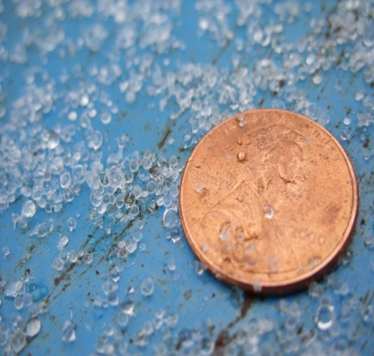
Types of Precipitation
Rain
Sleet
Snow
Hail

Slide 18
Air Masses
A large body of air that has properties similar to the part of the Earth’s surface over which it develops.

Slide 20
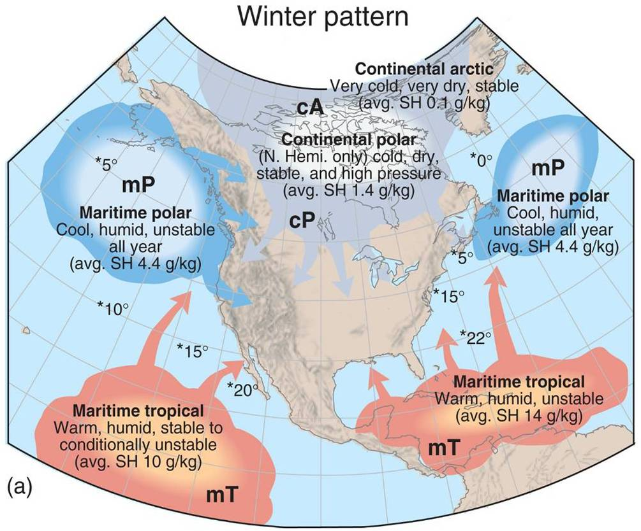
Air Mass Map

Slide 21
Fronts
A boundary between two air masses of different density, moisture, or temperature.

Slide 22
Cold Front

Slide 23
Warm Front

Slide 24
Occluded Front

Slide 25
Stationary Front

Slide 26
Severe Weather
Thunderstorms
Lightning
Tornadoes

Slide 27
More Severe Weather
Hurricanes
Blizzards

Slide 28
Severe Weather Safety
Watches- conditions are favorable
Warnings- conditions already exist
Examples- Tornadoes, Flooding, Thunderstorms, Blizzards, Winter Mixes and Hurricanes

Slide 30
Lightning

Slide 32
Tornado Alley

Slide 33
Fujiti Scale

Slide 34
Tornado Destruction

Slide 35
Weather Map

Slide 36
Hurricane

Slide 37
Hurricane Scale

Slide 38
Hurricane Destruction

Slide 39
NWS
Two sources of forecasting weather
Data collected from upper atmosphere
Data collected on the Earth’s surface

Slide 40
Isobars
Isobars-connect points of the “same”
Examples: temperature and wind speed
The further away the lines the lower the wind speed

