Slide 1
Rebellion
Road leading to the American Revolution

Slide 2
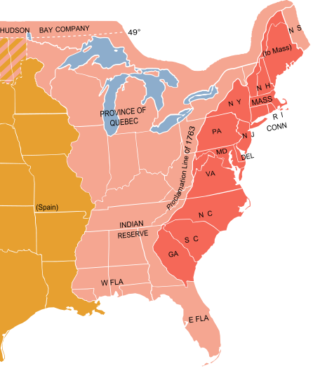
Proclamation of 1763
Act: This law banned the Colonists from settling west of the Appalachian Mountains.
Reaction: The proclamation was largely ignored on the ground but its very existence created a large amount of resentment among the British colonists.
Notes:
The first thing on the minds of colonists was the great western frontier that had opened to them when the French ceded that contested territory to the British. The royal proclamation of 1763 did much to dampen that celebration. The proclamation, in effect, closed off the frontier to colonial expansion. The King and his council presented the proclamation as a measure to calm the fears of the Indians, who felt that the colonists would drive them from their lands as they expanded westward. Many in the colonies felt that the object was to pen them in along the Atlantic seaboard where they would be easier to regulate. No doubt there was a large measure of truth in both of these positions. However the colonists could not help but feel a strong resentment when what they perceived to be their prize was snatched away from them. The proclamation provided that all lands west of the heads of all rivers which flowed into the Atlantic Ocean from the west or northwest were off-limits to the colonists. This excluded the rich Ohio Valley and all territory from the Ohio to the Mississippi rivers from settlement.
These facts were established immediately, but most of the proclamation is devoted to the subject of Indians and Indian lands. It asserted that all of the Indian peoples were thereafter under the protection of the King. It required that all lands within the "Indian territory" occupied by Englishmen were to be abandoned. It included a list of prohibited activities, provided for enforcement of the new laws, and indicted unnamed persons for fraudulent practices in acquiring lands from the Indians in times past. Resolution of the hostilities of the French and Indian War was a difficult problem for the crown. Most of the Indian tribes had been allied with the French during the war, because they found the French less hostile and generally more trustworthy that the English settlers. Now the French would depart, and the Indians were left behind to defend themselves and their grounds as best they could. Relations between the Indians and the English colonials were so poor that few settlers would argue in public that the Indians had rights to any lands. In this proclamation the King sided with the Indians, against the perceived interests of the settlers. Moreover, it provided, and Parliament soon after executed, British royal posts along the proclamation boundary. Parliament was under no illusions about relations between the Indians and the colonists. They understood that the colonists would not respect the boundary without some enforcement mechanism. Finally, the English were interested in improving the fur trade, which involved the Indians and independent trappers who lived out on the frontier. The Proclamation line extended from the Atlantic coast at Quebec to the newly established border of West Florida. Establishing and manning posts along the length of this boundary was a very costly undertaking. The British ministry would argue that these outposts were for colonial defense, and as such should be paid for by the colonies. From the American perspective this amounted to a tax on the colonies to pay for a matter of Imperial regulation that was opposed to the interests of the colonies. A bitter pill indeed.

Slide 3
After the French and Indian War
Great Britain has doubled their national debt
France is out for revenge
Relations between Colonists and Indians reach all time low
Proclamation of 1763
The stage is set for conflict

Slide 4
Great Britain needs , so what do they do?
Sugar Act (1764): tax on foreign refined sugar and increased taxes on coffee, indigo, and certain kinds of wine.
Reaction: In August 1764, fifty Boston merchants agreed to stop purchasing British luxury items, or boycott British goods, and in both Boston and New York there were movements to increase colonial manufacturing.
Notes:
put a three-cent tax on foreign refined sugar and increased taxes on coffee, indigo, and certain kinds of wine. It banned importation of rum and French wines. These taxes affected only a certain part of the population, but the affected merchants were very vocal. In August 1764, fifty Boston merchants agreed to stop purchasing British luxury items, and in both Boston and New York there were movements to increase colonial manufacturing.

Slide 5
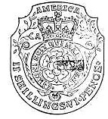
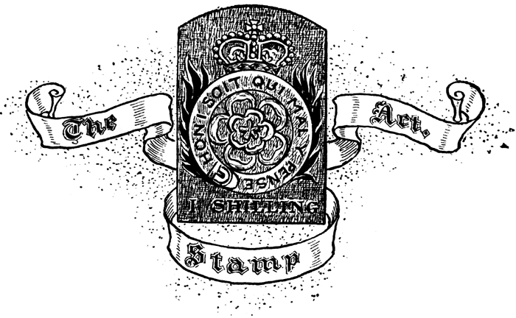
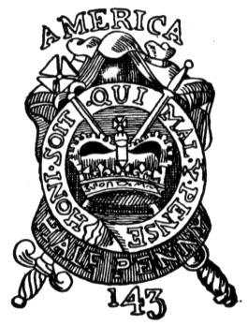
Stamp Act
The Stamp Act was passed in the British Parliament in 1765 introducing a tax on legal documents (etc.) in the North American colonies. The money collected by the Stamp Act was to be used to help pay the costs of defending and protecting the American frontier.
Notes:
The Stamp Act was passed in the British Parliament in 1765 introducing a tax on legal documents, commercial contracts, licenses, publications, and playing cards in the North American colonies. The money collected by the Stamp Act was to be used to help pay the costs of defending and protecting the American frontier near the Appalachian Mountains (10,000 troops were to be stationed on the American frontier for this purpose).

Slide 6
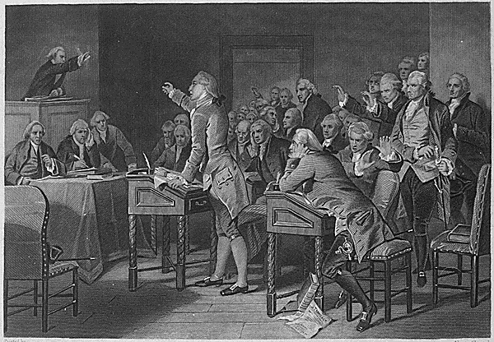
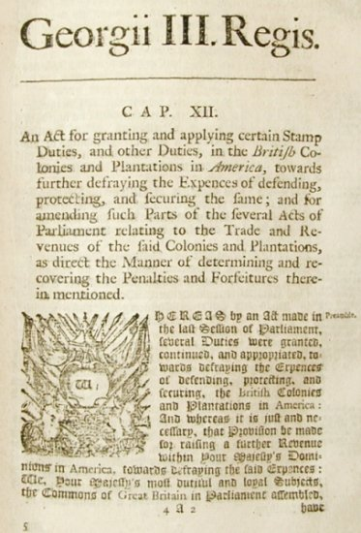
Reaction to the Stamp Act
The Stamp Act met with great resistance in the colonies. It was seen as a violation of the right of Englishmen to be taxed only with their consent—consent which could only be granted through their colonial legislatures.
Colonial assemblies sent petitions of protests, and the Stamp Act Congress, reflecting the first joint colonial response to any British measure, also petitioned Parliament and the king.
Local protest groups established connections through correspondence that created a loose coalition that extended from New England to Georgia.
NO TAXATION WITHOUT
REPRESENTATION
Notes:
The Stamp Act met with great resistance in the colonies. It was seen as a violation of the right of Englishmen to be taxed only with their consent—consent which could only be granted through their colonial legislatures.
Colonial assemblies sent petitions of protests, and the Stamp Act Congress, reflecting the first significant joint colonial response to any British measure, also petitioned Parliament and the king.
Local protest groups, led by colonial merchants and landowners, established connections through correspondence that created a loose coalition that extended from New England to Georgia.

Slide 7
Reaction to the Stamp Act
Protests initiated by the Sons of Liberty often turned violent as the masses became involved. Very soon all stamp tax distributors were forced to quit their jobs.
Opposition to the Stamp Act was not limited to the colonies. British merchants , whose exports to the colonies were threatened by colonial problems, also pressured Parliament.
The Act was repealed but Parliament affirmed its power to legislate for the colonies “in all cases whatsoever” by also passing the Declaratory Act.
Notes:
Protests and demonstrations initiated by the Sons of Liberty often turned violent and destructive as the masses became involved. Very soon all stamp tax distributors were intimidated into resigning their commissions, and the tax was never effectively collected.
Opposition to the Stamp Act was not limited to the colonies. British merchants and manufacturers, whose exports to the colonies were threatened by colonial economic problems exacerbated by the tax, also pressured Parliament.
The Act was repealed on 18 March 1766 as a matter of expedience, but Parliament affirmed its power to legislate for the colonies “in all cases whatsoever” by also passing the Declaratory Act.

Slide 8
Townshend Act
The purpose of the Townshend Acts was to:
Raise money to pay British soldiers and judges
To force the colonists to obey trade regulations
To punish the province of New York for disobeying the 1765 Quartering Act
To make sure the colonists knew that the British Parliament had the right to tax the colonies.
Reaction: The Townshend Acts met with resistance in the colonies, prompting the occupation of Boston by British troops in 1768, which eventually resulted in the Boston Massacre of 1770.
Duties on imported glass, lead, paint, paper, and tea.
Charles Townshend
Notes:
The purpose of the Townshend Acts was to:
raise revenue in the colonies to pay the salaries of governors and judges so that they would be independent of colonial control,
to create a more effective means of enforcing compliance with trade regulations,
to punish the province of New York for failing to comply with the 1765 Quartering Act
and to establish the precedent that the British Parliament had the right to tax the colonies.
The Townshend Acts met with resistance in the colonies, prompting the occupation of Boston by British troops in 1768, which eventually resulted in the Boston Massacre of 1770.
Ironically, on the same day as the massacre in Boston, Parliament began to consider a motion to partially repeal the Townshend duties. Most of the new taxes were repealed

Slide 9
List all the examples of why this etching is propaganda

Slide 10
The TEA ACT, passed by Parliament on May 10, 1773, would launch the final spark to the revolutionary movement in Boston. It was designed to help the East India Company which was burdened with 18 MILLION POUNDS of unsold tea. This tea was to be shipped directly to the colonies, and sold at a bargain price.
Reaction: Colonists worried that the British East India Company would monopolize the tea trade and that would hurt colonial merchants.
Notes:
Colonists in Philadelphia and New York turned the tea ships back to Britain. In Charleston the cargo was left to rot on the docks. In Boston the Royal Governor was stubborn & held the ships in port, where the colonists would not allow them to unload. Cargoes of tea filled the harbor, and the British ship's crews were stalled in Boston looking for work and often finding trouble. This situation lead to the Boston Tea Party.

Slide 11
What Actually Happened at the Boston Tea Party?

Slide 12
Overall….
Colonial Leaders in Boston propose a boycott of all British goods in the colonies.
They also try to bring together leaders from each colony to decide the best way to respond to Britain's abuses of colonial rights.

